Slide 1
PROGRAMMING FOR DATA SCIENCE
Program Elective-II
UNIT-1
Presented by
Dr. J. karthik M.Tech., Ph.D
Assistant Professor,
Department of CSE,
VRSEC.
Branch: III B.Tech VI Semester(CSE)
Course Coordinator: Dr. J. Karthik

Slide 2
Syllabus:-Introduction: AI, Machine Learning and Data Science;
What is data Science: Extracting Meaningful patterns, Building representative models, Combination of statistics, Machine learning and Computing, learning
Algorithms, Associated fields.
Case for Data Science: Volume, Dimensions, Complex Questions;
Data Science Classification, Data Science Algorithms.
Getting to Know your Data: Data Objects and Attribute Types, Basic Statistical Descriptions of Data, Data Visualization, Measuring Data Similarity and Dissimilarity

Slide 3
PREREQUISITES
Familiar with basic mathematics
Good in Database management systems
Prescribed Text book
[1] Vijay Kotu and Bala Deshpande, Data Science concepts and Practice, 2019, Second Edition.
[2] Jiawei Han, Micheline Kamber, Jian Pei , Data mining : concepts and techniques, 2012. Third edition.
Reference Text books
[1]Joel Grus , Data Science from Scratch, 2019, 2nd Edition..
[2]Emily Robinson and Jacqueline Nolis, Build a Career in Data Science,Manning, 2020

Slide 4
Learning Outcomes
Upon successful completion of the course, the students will be able to
Understand the fundamentals of Data Science concepts.
Apply various pre-processing techniques in Data Science.
Apply various schemas and operations of the Data Warehouse.
Analyze different types of data science algorithms to solve real life problems.

Slide 5
Unit-1: Introduction, What is data Science?, Case for Data Science, Getting to Know your Data
Unit-2: Data Preprocessing, Data Integration, Data Reduction & Data Transformation and Data Discretization
Unit-3:Data Warehouse Basic Concepts & Data Warehouse Modeling
Unit-4: Mining Frequent Patterns, Associations, Classification, Cluster Analysis

Slide 6
INTRODUCTION:AI,MACHINE LEARNING and DATA SCIENCE
Data science is a collection of techniques used to extract value from data.
It has become an essential tool for any organization that collects, stores, and processes data as part of its operations.
Data science techniques rely on finding useful patterns, connections, and relationships within data.
Data science is also commonly referred to as knowledge discovery, machine learning, predictive analytics, and data mining. However, each term has a slightly different connotation depending on the context.

Slide 7
Engineers and scientists have been using predictive models since the beginning of 19th century.
So, who uses data science today? Almost every organization and business.

Slide 8
The use of the term science in data science indicates that the methods are evidence based, and are built on empirical knowledge, more specifically historical observations.
As the ability to collect, store, and process data has increased, in line with Moore’s Law - which implies that computing hardware capabilities double every two years, data science has found increasing applications in many diverse fields.
Just decades ago, building a production quality regression model took about several dozen hours.
Today, sophisticated machine learning models can be run, involving hundreds of predictors with millions of records in a matter of a few seconds on a laptop/Desktop computer.

Slide 9
Artificial intelligence, Machine learning, and Data science are all related to each other.
Artificial intelligence is about giving machines the capability of mimicking human behavior, particularly cognitive functions.
Examples : facial recognition, automated driving, sorting mail based on postal code.
There are quite a range of techniques that fall under artificial intelligence: linguistics, natural language processing, decision science, bias, vision, robotics, planning, etc.
Learning is an important part of human capability. In fact, many other living organisms can learn.

Slide 10
Machine learning can either be considered a sub-field or one of the tools of artificial intelligence, is providing machines with the capability of learning from experience.
Experience for machines comes in the form of data.
Data that is used to teach machines is called training data.
A program, a set of instructions to a computer, transforms input signals into output signals using predetermined rules and relationships.
Machine learning algorithms also called “learners”, take both the known input and output (training data) to figure out a model for the program which converts input to output.

Slide 11
Example: For example, many organizations like social media platforms, review sites, or forums are required to moderate posts and remove abusive content. How can machines be taught to automate the removal of abusive content? The machines need to be shown examples of both abusive and non-abusive posts with a clear indication of which one is abusive.

Slide 12
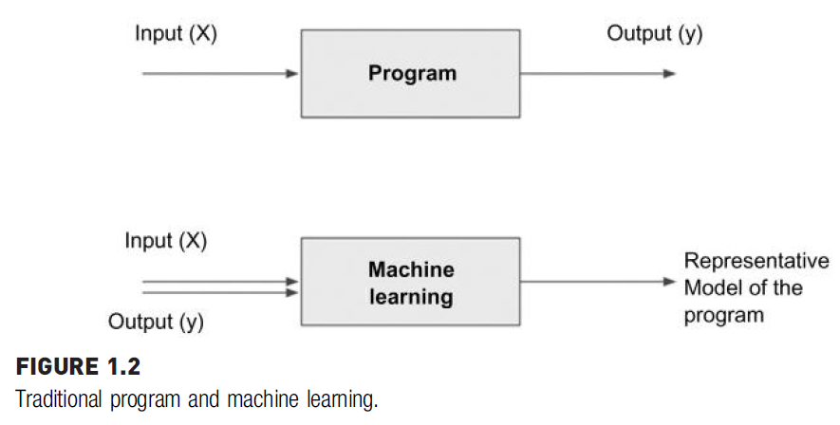

Slide 13
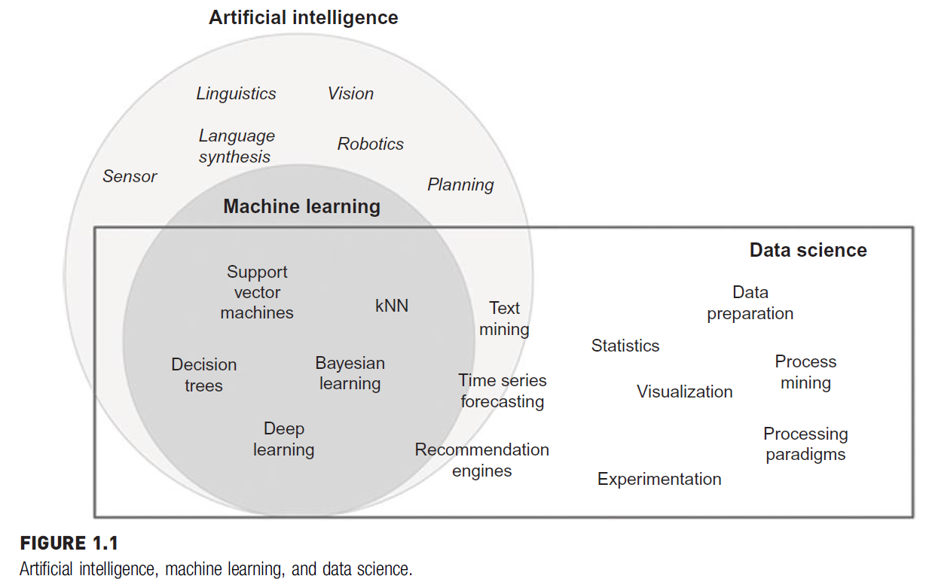

Slide 14
Data science is the business application of machine learning, artificial intelligence, and other quantitative fields like statistics, visualization, and mathematics.
It is an interdisciplinary field that extracts value from data.
In the context of how data science is used today, it relies heavily on machine learning and is sometimes called data mining.
Examples of data science use cases are:
Recommendation engines that can recommend movies for a particular user
Fraud alert model that detects fraudulent credit card transactions.
Find customers who will most likely churn next month, or predict revenue for the next quarter

Slide 15
Definitions of Data Science
Data science is an interdisciplinary academic field that uses statistics, scientific computing, scientific methods, processes, algorithms and systems to extract or extrapolate knowledge and insights from noisy, structured and unstructured data
or
Data science is the study of data to extract meaningful insights for business. It is a multidisciplinary approach that combines principles and practices from the fields of mathematics, statistics, artificial intelligence, and computer engineering to analyze large amounts of data.

Slide 16
AI: Artificial intelligence is the simulation of human intelligence processes by machines, especially computer systems.
ML: Machine learning is an application of AI that enables systems to learn and improve from experience without being explicitly programmed.
DL: This subset of AI is a technique that is inspired by the way a human brain filters information. It is associated with learning from examples. DL systems help a computer model to filter the input data through layers to predict and classify information. Deep Learning processes information in the same manner as the human brain

Slide 17
WHAT IS DATA SCIENCE?
Data science starts with data, which can range from a simple array of a few numeric observations to a complex matrix of millions of observations with thousands of variables.
Data science utilizes certain specialized computational methods in order to discover meaningful and useful structures within a dataset.
The discipline of data science coexists and is closely associated with a number of related areas such as database systems, data engineering, visualization, data analysis, experimentation, and business intelligence (BI).

Slide 18
Extracting Meaningful Patterns
Knowledge discovery in databases is the nontrivial process of identifying valid, novel, potentially useful, and ultimately understandable patterns or relationships within a dataset in order to make important decisions.
One of the key aspects of data science is the process of generalization of patterns from a dataset.
The generalization should be valid, not just for the dataset used to observe the pattern, but also for new unseen data.
Data science is also a process with defined steps, each with a set of tasks

Slide 19
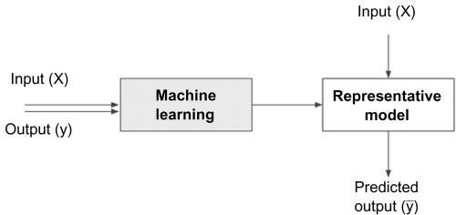
The term novel indicates that data science is usually involved in finding previously unknown patterns in data.
The ultimate objective of data science is to find potentially useful conclusions that can be acted upon by the users of the analysis
Figure: Data science models

Slide 20
Building Representative Models
In statistics, a model is the representation of a relationship between variables in a dataset.
It describes how one or more variables in the data are related to
other variables.
Modeling is a process in which a representative abstraction is built from the observed dataset.
For example, based on credit score, income level, and requested loan amount, a model can be developed to determine the interest rate of a loan.
For this task, previously known observational data including credit score, income level, loan amount, and interest rate are needed

Slide 21
shows the process of generating a model. Once the representative model is created, it can be used to predict the value of the interest rate, based on all the input variables

Slide 22
Data science is the process of building a representative model that fits the observational data
This model serves two purposes:
on the one hand, it predicts the output (interest rate) based on the new and unseen set of input variables (credit score, income level, and loan amount), and
on the other hand, the model can be used to understand the relationship between the output variable and all the input variables

Slide 23
Combination of Statistics, Machine Learning, and Computing
In the pursuit of extracting useful and relevant information from large datasets, data science borrows computational techniques from the disciplines of statistics, machine learning, experimentation, and database theories.
The algorithms used in data science originate from these disciplines but have since evolved to adopt more diverse techniques such as parallel computing, evolutionary computing, linguistics, and behavioral studies.

Slide 24
One of the key ingredients of successful data science is substantial prior knowledge about the data and the business processes that generate the data, known as subject matter expertise.
Data science is an iterative process in which the practitioner gains more information about the patterns and relationships from data in each cycle.
Data science also typically operates on large datasets that need to be stored, processed, and computed.(Ex: maps from Google)
This is where database techniques along with parallel and distributed computing techniques play an important role in data science.

Slide 25
Learning Algorithms
We can also define data science as a process of discovering previously unknown patterns in data using automatic iterative methods.
The application of sophisticated learning algorithms for extracting useful patterns from data differentiates data science from traditional data analysis techniques.
Many of these algorithms were developed in the past few decades and are a part of machine learning and artificial intelligence.

Slide 26
Some algorithms are based on the foundations of Bayesian probabilistic theories and regression analysis, originating from hundreds of years ago.
These iterative algorithms automate the process of searching for an optimal solution for a given data problem.
Based on the problem, data science is classified into tasks such as classification, association analysis, clustering, and regression
Each data science task uses specific learning algorithms like decision trees, neural networks, k-nearest neighbors (k-NN), and k-means clustering, among others.

Slide 27
Associated Fields
While data science covers a wide set of techniques, applications, and disciplines, there a few associated fields that data science heavily relies on
Descriptive statistics:
Computing mean, standard deviation, correlation, and other descriptive statistics, quantify the aggregate structure of a dataset.
This is essential information for understanding any dataset in order to understand the structure of the data and the relationships within the dataset.
They are used in the exploration stage of the data science process
Descriptive statistics is a means of describing features of a data set by generating summaries about data samples.

Slide 28
Exploratory visualization:
The process of expressing data in visual coordinates enables users to find patterns and relationships in the data and to comprehend large datasets.
Similar to descriptive statistics, they are integral in the pre- and post-processing steps in data science

Slide 29
Dimensional slicing:
Online analytical processing (OLAP) applications, which are prevalent in organizations, mainly provide information on the data through dimensional slicing, filtering, and pivoting.
OLAP analysis is enabled by a unique database schema design where the data are organized as dimensions (e.g., products, regions, dates) and quantitative facts or measures (e.g., revenue, quantity)
With a well defined database structure, it is easy to slice the yearly revenue by products or combination of region and products.
These techniques are extremely useful and may unveil patterns in data (e.g., candy sales decline after Halloween in the United States).

Slide 30
Hypothesis testing
In confirmatory data analysis, experimental data are collected to evaluate whether a hypothesis has enough evidence to be supported or not.
There are many types of statistical testing and they have a wide variety of business applications (e.g., A/B testing in marketing)
In general, data science is a process where many hypotheses are generated and tested based on observational data.
Since the data science algorithms are iterative, solutions can be refined in each step.

Slide 31
Data engineering:
Data engineering is the process of sourcing, organizing, assembling, storing, and distributing data for effective analysis and usage.
Data engineering helps source and prepare for data science learning algorithms.
Business intelligence:
Business intelligence helps organizations consume data effectively.
Historical trends are usually reported, but in combination with data science, both the past and the predicted future data can be combined.

Slide 32
CASE FOR DATA SCIENCE
In the past few decades, a massive accumulation of data has been seen with the advancement of information technology, connected networks, and the businesses it enables.
This trend is also coupled with a steep decline in data storage and data processing costs.
The applications built on these advancements like online businesses, social networking, and mobile technologies unleash a large amount of complex, heterogeneous data that are waiting to be analyzed.
Traditional analysis techniques like dimensional slicing, hypothesis testing, and descriptive statistics can only go so far in information discovery.

Slide 33
A paradigm is needed to manage the massive volume of data, explore the inter-relationships of thousands of variables, and deploy machine learning algorithms to deduce optimal insights from datasets.
A set of frameworks, tools, and techniques are needed to intelligently assist humans to process all these data and extract valuable information.
Data science is one such paradigm that can handle large volumes with multiple attributes and deploy complex algorithms to search for patterns from data.

Slide 34
Volume
The sheer volume of data captured by organizations is exponentially increasing.
The rapid decline in storage costs and advancements in capturing every transaction and event, combined with the business need to extract as much leverage as possible using data, creates a strong motivation to store more data than ever.
As data become more granular, the need to use large volume data to extract information increases.
In a few implementations, the time to create generalization models is critical and data volume plays a major part in determining the time frame of development and deployment.

Slide 35
Dimensions
The three characteristics of the Big Data phenomenon are high volume, high velocity, and high variety.
The variety of data relates to the multiple types of values (numerical, categorical), formats of data (audio files, video files), and the application of the data (location coordinates, graph data).
Every single record or data point contains multiple attributes or variables to provide context for the record.
For example, every user record of an ecommerce site can contain attributes such as products viewed, products purchased, user demographics, frequency of purchase, clickstream, etc

Slide 36
Determining the most effective offer for an ecommerce user can involve computing information across these attributes.
Each attribute can be thought of as a dimension in the data space.
The user record has multiple attributes and can be visualized in multidimensional space.
The addition of each dimension increases the complexity of analysis techniques.
A simple linear regression model that has one input dimension is relatively easy to build compared to multiple linear regression models with multiple dimensions

Slide 37
In the case of text mining, a document or article becomes a data point with each unique word as a dimension.
Text mining yields a dataset where the number of attributes can range from a few hundred to hundreds of thousands of attributes.

Slide 38
Complex Questions
As more complex data are available for analysis, the complexity of information that needs to get extracted from data is increasing as well.
If the natural clusters in a dataset, with hundreds of dimensions, need to be found, then traditional analysis like hypothesis testing techniques cannot be used in a scalable fashion.
The machine-learning algorithms need to be leveraged in order to automate searching in the vast search space.

Slide 39
Machine learning approaches the problem of modeling by trying to find an algorithmic model that can better predict the output from input variables. The algorithms are usually recursive and, in each cycle, estimate the output and “learn” from the predictive errors of the previous steps.
In the context of the data problems faced today, both techniques need to be deployed. John Tuckey, in his article “We need both exploratory and confirmatory,” stresses the importance of both exploratory and confirmatory analysis techniques

Slide 40
DATA SCIENCE CLASSIFICATION
Data science problems can be broadly categorized into supervised or unsupervised learning models.
Supervised or directed data science tries to infer a function or relationship based on labeled training data and uses this function to map new unlabeled data.
Supervised techniques predict the value of the output variables based on a set of input variables.
To do this, a model is developed from a training dataset where the values of input and output are previously known.

Slide 41
The model generalizes the relationship between the input and output variables and uses it to predict for a dataset where only input variables are known.
The output variable that is being predicted is also called a class label or target variable.
Supervised data science needs a sufficient number of labeled records to learn the model from the data.
Unsupervised or undirected data science uncovers hidden patterns in unlabeled data.
In unsupervised data science, there are no output variables to predict.
The objective of this class of data science techniques, is to find patterns in data based on the relationship between data points themselves.

Slide 42
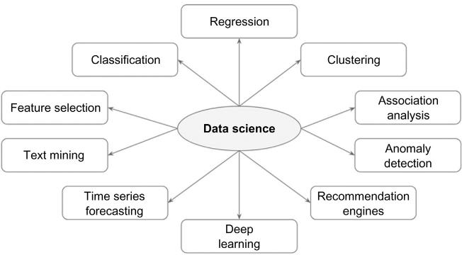
An application can employ both supervised and unsupervised learners.
Data science problems can also be classified into tasks such as: classification, regression, association analysis, clustering, anomaly detection, recommendation engines, feature selection, time series forecasting, deep learning, and text mining
Data science tasks

Slide 43
Classification and regression techniques predict a target variable based on input variables.
The prediction is based on a generalized model built from a previously known dataset.
In regression tasks, the output variable is numeric (e.g., the mortgage interest rate on a loan).
Classification tasks predict output variables, which are categorical or polynomial (e.g., the yes or no decision to approve a loan).
Deep learning is a more sophisticated artificial neural network that is increasingly used for classification and regression problems.
Clustering is the process of identifying the natural groupings in a dataset

Slide 44
In retail analytics, it is common to identify pairs of items that are purchased together, so that specific items can be bundled or placed next to each other. This task is called market basket analysis or association analysis, which is commonly used in cross selling.
Recommendation engines are the systems that recommend items to the users based on individual user preference.
Anomaly or outlier detection identifies the data points that are significantly different from other data points in a dataset.
Example: Credit card transaction fraud detection is one of the most prolific applications of anomaly detection

Slide 45
Time series forecasting is the process of predicting the future value of a variable (e.g., temperature) based on past historical values that may exhibit a trend and seasonality.
Text mining is a data science application where the input data is text, which can be in the form of documents, messages, emails, or web pages.
To aid the data science on text data, the text files are first converted into document vectors where each unique word is an attribute. Once the text file is converted to document vectors, standard data science tasks such as classification, clustering, etc., can be applied.
Feature selection is a process in which attributes in a dataset are reduced to a few attributes that really matter

Slide 46
A complete data science application can contain elements of both supervised and unsupervised techniques (Tan et al., 2005).
Unsupervised techniques provide an increased understanding of the dataset and hence, are sometimes called descriptive data science.

Slide 47
DATA SCIENCE ALGORITHMS
An algorithm is a logical step-by-step procedure for solving a problem.
In data science, it is the blueprint for how a particular data problem is solved.
Many of the learning algorithms are recursive, where a set of steps are repeated many times until a limiting condition is met.
Some algorithms also contain a random variable as an input and are aptly called randomized algorithms.
A classification task can be solved using many different learning algorithms such as decision trees, artificial neural networks, k-NN, and even some regression algorithms.

Slide 48
The choice of which algorithm to use depends on the type of dataset, objective, structure of the data, presence of outliers, available computational power, number of records, number of attributes, and so on.
It is up to the data science practitioner to decide which algorithm (s) to use by evaluating the performance of multiple algorithms.
Data science algorithms can be implemented by custom-developed computer programs in almost any computer language. Data science tools or statistical programming tools, like R, RapidMiner, Python, SAS Enterprise Miner, etc., which can implement these algorithms with ease, can be leveraged.

Slide 49
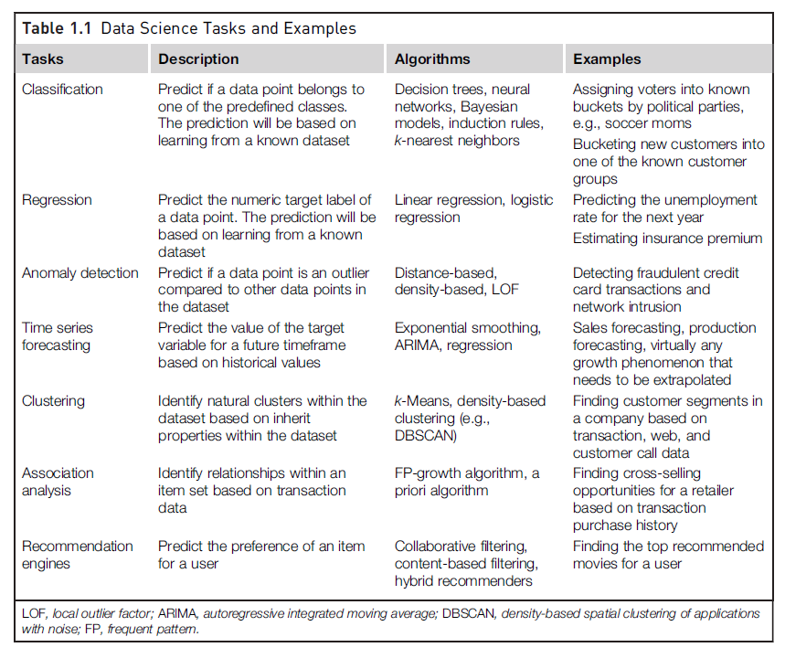
Table 1.1 provides a summary of data science tasks with commonly used algorithmic techniques and example cases.

Slide 50
Getting to Know your Data
Real-world data are typically noisy, enormous in volume (often several gigabytes or more), and may originate from a hodgepodge of heterogeneous sources.
Knowledge about your data is useful for data preprocessing i.e the first major task of the data mining process.
You want to know the following
What are the types of attributes or fields that make up your data?
What kind of values does each attribute have?
Which attributes are discrete, and which are continuous-valued?
What do the data look like?
How are the values distributed?
Are there ways we can visualize the data to get a better sense of it all?
Can we spot any outliers?
Can we measure the similarity of some data objects with respect to others?
Gaining such insight into the data will help with the subsequent analysis.

Slide 51
“So what can we learn about our data that’s helpful in data preprocessing?” We begin by studying the various attribute types.
These include
Nominal attributes
Binary attributes
Ordinal attributes
Numeric attributes
Basic statistical descriptions can be used to learn more about each attribute’s values
Given a temperature attribute, for example, we can determine its mean (average value), median (middle value), and mode (most common value).
These are measures of central tendency, which give us an idea of the “middle” or center of distribution

Slide 52
Knowing such basic statistics regarding each attribute makes it easier to fill in missing values, smooth noisy values, and spot outliers during data preprocessing.
Knowledge of the attributes and attribute values can also help in fixing inconsistencies incurred during data integration.
Plotting the measures of central tendency shows us if the data are symmetric or skewed.(Refer slide no 83)
Quantile plots, histograms, and scatter plots are other graphic displays of basic statistical descriptions.
The field of data visualization provides many additional techniques for viewing data through graphical means.
These can help identify relations, trends, and biases “hidden” in unstructured data sets.

Slide 53
Data Objects and Attribute Types
Data sets are made up of data objects.
A data object represents an entity—
In a sales database, the objects may be customers, store items, and sales;
in a medical database, the objects may be patients;
in a university database, the objects may be students, professors, and courses.
Data objects are typically described by attributes.
Data objects can also be referred to as samples, examples, instances, data points, or objects.
If the data objects are stored in a database, they are data tuples.

Slide 54
That is, the rows of a database correspond to the data objects, and the columns correspond to the attributes.
What Is an Attribute?
An attribute is a data field, representing a characteristic or feature of a data object.
The nouns attribute, dimension, feature, and variable are often used interchangeably in the literature.
The term dimension is commonly used in data warehousing.
Machine learning literature tends to use the term feature.
statisticians prefer the term variable.
Data mining and database professionals commonly use the term attribute.
Attributes describing a customer object can include, for example, customer ID, name, and address.
Observed values for a given attribute are known as observations.

Slide 55
A set of attributes used to describe a given object is called an attribute vector (or feature vector)
The distribution of data involving one attribute (or variable) is called univariate.
A bivariate distribution involves two attributes, and so on.
The type of an attribute is determined by the set of possible values—nominal, binary, ordinal, or numeric.
Nominal Attributes
Nominal means “relating to names.”
The values of a nominal attribute are symbols or names of things.
Each value represents some kind of category, code, or state, and so nominal attributes are also referred to as categorical.
The values do not have any meaningful order.
In computer science, the values are also known as enumerations

Slide 56
Example:
Suppose that hair color and marital status are two attributes describing person objects. In our application, possible values for hair color are black, brown, blond, red, auburn, gray, and white.
The attribute marital status can take on the values single, married, divorced, and widowed.
Both hair color and marital status are nominal attributes.
Another example of a nominal attribute is occupation, with the values teacher, dentist, programmer, farmer
Because nominal attribute values do not have any meaningful order about them and are not quantitative.
It makes no sense to find the mean (average) value or median (middle) value for such an attribute, given a set of objects.

Slide 57
Binary Attributes
A binary attribute is a nominal attribute with only two categories or states: 0 or 1, where 0 typically means that the attribute is absent, and 1 means that it is present.
Binary attributes are referred to as Boolean if the two states correspond to true and false.
Example: Binary attributes. Given the attribute smoker describing a patient object, 1 indicates that the patient smokes, while 0 indicates that the patient does not.
patient undergoes a medical test that has two possible outcomes. The attribute medical test is binary, where a value of 1 means the result of the test for the patient is positive, while 0 means the result is negative.

Slide 58
A binary attribute is symmetric if both of its states are equally valuable and carry the same weight that is, there is no preference on which outcome should be coded as 0 or 1.
Example: One such example could be the attribute gender having the states male and female.
A binary attribute is asymmetric if the outcomes of the states are not equally important, such as the positive and negative outcomes of a medical test for HIV.
By convention, we code the most important outcome, which is usually the rarest one, by 1 (e.g., HIV positive) and the other by 0 (e.g., HIV negative).

Slide 59
Ordinal Attributes
An ordinal attribute is an attribute with possible values that have a meaningful order or ranking among them, but the magnitude between successive values is not known.
Example: Suppose that drink size corresponds to the size of drinks available at a fast-food restaurant. This nominal attribute has three possible values: small, medium, and large. The values have a meaningful sequence (which corresponds to increasing drink size); however, we cannot tell from the values how much bigger, say, a medium is than a large.
Other examples of ordinal attributes include grade (e.g., A+, A, A−, B+, and so on) and professional rank.
Professional ranks can be enumerated in a sequential order:
Example: assistant, associate, and full for professors, and private, private first class, specialist, corporal, and sergeant for army ranks

Slide 60
ordinal attributes are often used in surveys for ratings.
In one survey, participants were asked to rate how satisfied they were as customers. Customer satisfaction had the following ordinal categories:
0: very dissatisfied,
1: somewhat dissatisfied,
2: neutral,
3: satisfied,
4: very satisfied
The central tendency of an ordinal attribute can be represented by its mode and its median (the middle value in an ordered sequence), but the mean cannot be defined.
Nominal, binary, and ordinal attributes are qualitative. That is, they describe a feature of an object without giving an actual size or quantity.
Numeric attributes, which provide quantitative measurements of an
object.

Slide 61
Numeric Attributes
A numeric attribute is quantitative; that is, it is a measurable quantity, represented in integer or real values.
Numeric attributes can be interval-scaled or ratio-scaled.
Interval-Scaled Attributes
Interval-scaled attributes are measured on a scale of equal-size units. The values of interval-scaled attributes have order and can be positive, 0, or negative. Thus, in addition to providing a ranking of values, such attributes allow us to compare and quantify the difference between values.
Example: A temperature attribute is interval-scaled. Suppose that we have the outdoor temperature value for a number of different days, where each day is an object. By ordering the values, we obtain a ranking of the objects with respect to temperature. In addition, we can quantify the difference between values. For example, a temperature of 20◦C is five degrees higher than a temperature of 15◦C.

Slide 62
Because interval-scaled attributes are numeric, we can compute their mean value, in addition to the median and mode measures of central tendency.
Length, area, and population are examples of ratio scales.

Slide 63
Ratio-Scaled Attributes
A ratio-scaled attribute is a numeric attribute with an inherent zero-point.
That is, if a measurement is ratio-scaled, we can speak of a value as being a multiple (or ratio) of another value.
In addition, the values are ordered, and we can also compute the difference between values, as well as the mean, median, and mode.
Examples:Other examples of ratio-scaled attributes include count attributes such as years of experience (e.g., the objects are employees) and number of words (e.g., the objects are documents).
Additional examples include attributes to measure weight, height, and speed, and monetary quantities (e.g., you are 100 times richer with $100 than with $1).
A ratio scale is a quantitative scale where there is a true zero and equal intervals between neighboring points. Unlike on an interval scale, a zero on a ratio scale means there is a total absence of the variable you are measuring.

Slide 64
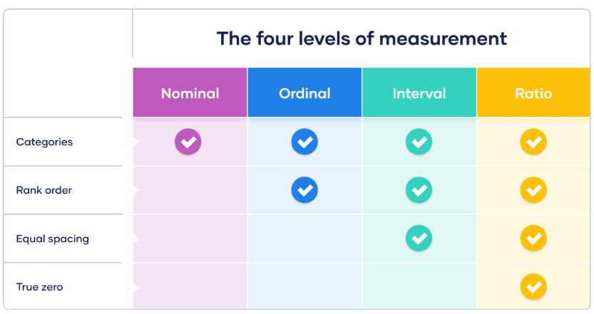

Slide 65
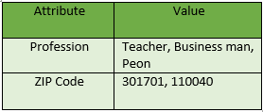
Discrete versus Continuous Attributes
Classification algorithms developed from the field of machine learning often talk of attributes as being either discrete or continuous.
A discrete attribute has a finite or countably infinite set of values, which may or may not be represented as integers.
Example: The attributes hair color, smoker, medical test, and drink size each have a finite number of values, and so are discrete.
Note that discrete attributes may have numeric values, such as 0 and 1 for binary attributes or, the values 0 to 110 for the attribute age.

Slide 66
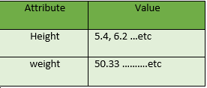
If an attribute is not discrete, it is continuous.
Continuous data have an infinite no of states.
Continuous attributes are typically represented as floating-point variables. There can be many values between 2 and 3.

Slide 67
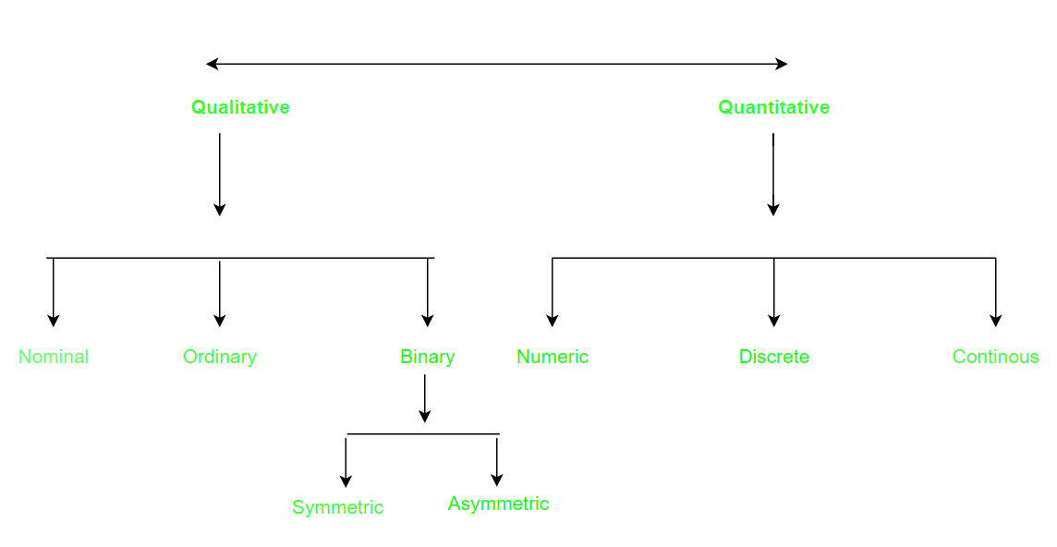

Slide 68
Basic Statistical Descriptions of Data
For data preprocessing to be successful, it is essential to have an overall picture of your data.
Basic statistical descriptions can be used to identify properties of the data and highlight which data values should be treated as noise or outliers.
Measures of central tendency which measure the location of the middle or center of a data distribution.
Intuitively speaking, given an attribute, where do most of its values fall? In particular, we discuss the mean, median, mode, and midrange.
Dispersion of the data, that is, how are the data spread out? The most
common data dispersion measures are the range, quartiles, and interquartile range; the five-number summary and boxplots; and the variance and standard deviation of the data. These measures are useful for identifying outliers.

Slide 69
Finally, we can use many graphic displays of basic statistical descriptions to visually inspect our data.
Most statistical or graphical data presentation software packages include bar charts, pie charts, and line graphs.
Other popular displays of data summaries and distributions include quantile plots, quantile–quantile plots, histograms, and scatter plots

Slide 70
Measuring the Central Tendency: Mean, Median, and Mode
we look at various ways to measure the central tendency of data.
Suppose that we have some attribute X, like salary, which has been recorded for a set of objects. Let x1,x2, . . . ,xN be the set of N observed values or observations for X. Here, these values may also be referred to as the data set (for X).
If we were to plot the observations for salary, where would most of the values fall?
This gives us an idea of the central tendency of the data.

Slide 71
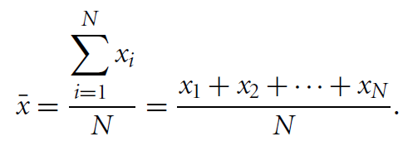
The most common and effective numeric measure of the “center” of a set of data is the (arithmetic) mean.
Let x1,x2, . . . ,xN be a set of N values or observations, such as for some numeric attribute X, like salary.
The mean of this set of values is
This corresponds to the built-in aggregate function, average (avg() in SQL), provided in relational database systems.

Slide 72
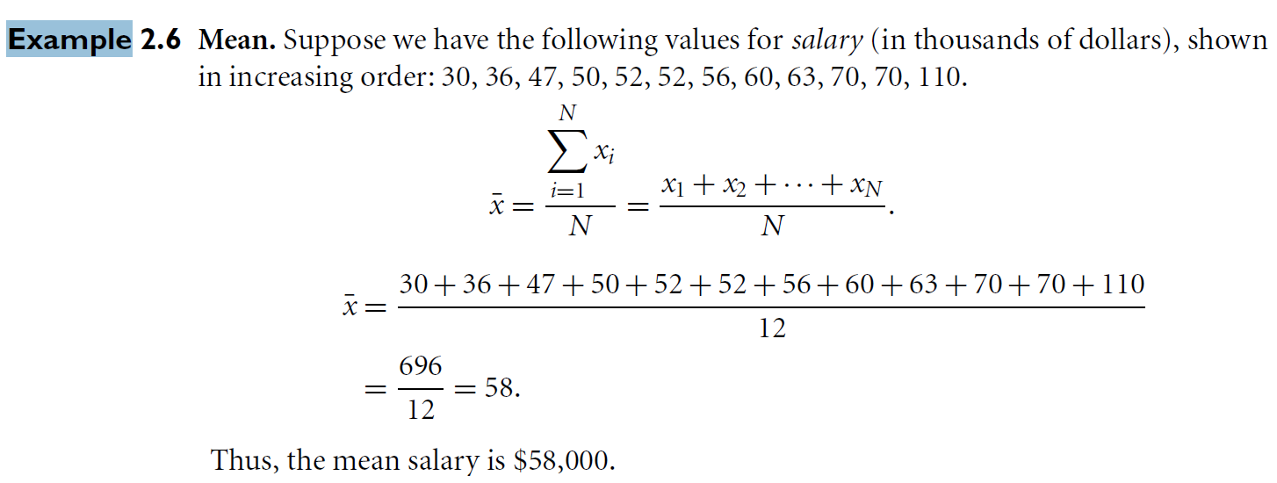
Example

Slide 73
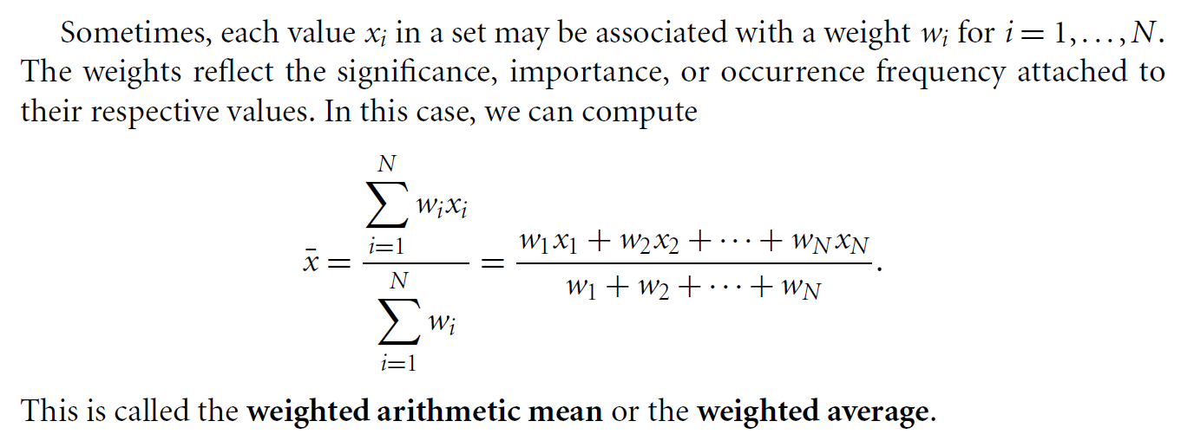

Slide 74
Although the mean is the single most useful quantity for describing a data set, it is not always the best way of measuring the center of the data.
Major problem with the mean is its sensitivity to extreme (e.g., outlier) values.
Even a small number of extreme values can corrupt the mean.
Example, the mean salary at a company may be substantially pushed up by that of a few highly paid managers.
Similarly, the mean score of a class in an exam could be pulled down quite a bit by a few very low scores.

Slide 75
To offset the effect caused by a small number of extreme values, we can instead use the trimmed mean which is the mean obtained after chopping off values at the high and low extremes.
Example, we can sort the values observed for salary and remove the top and bottom 2% before computing the mean.
We should avoid trimming too large a portion (such as 20%) at both ends, as this can result in the loss of valuable information.
For skewed (asymmetric) data, a better measure of the center of data is the median, which is the middle value in a set of ordered data values. It is the value that separates the higher half of a data set from the lower half

Slide 76
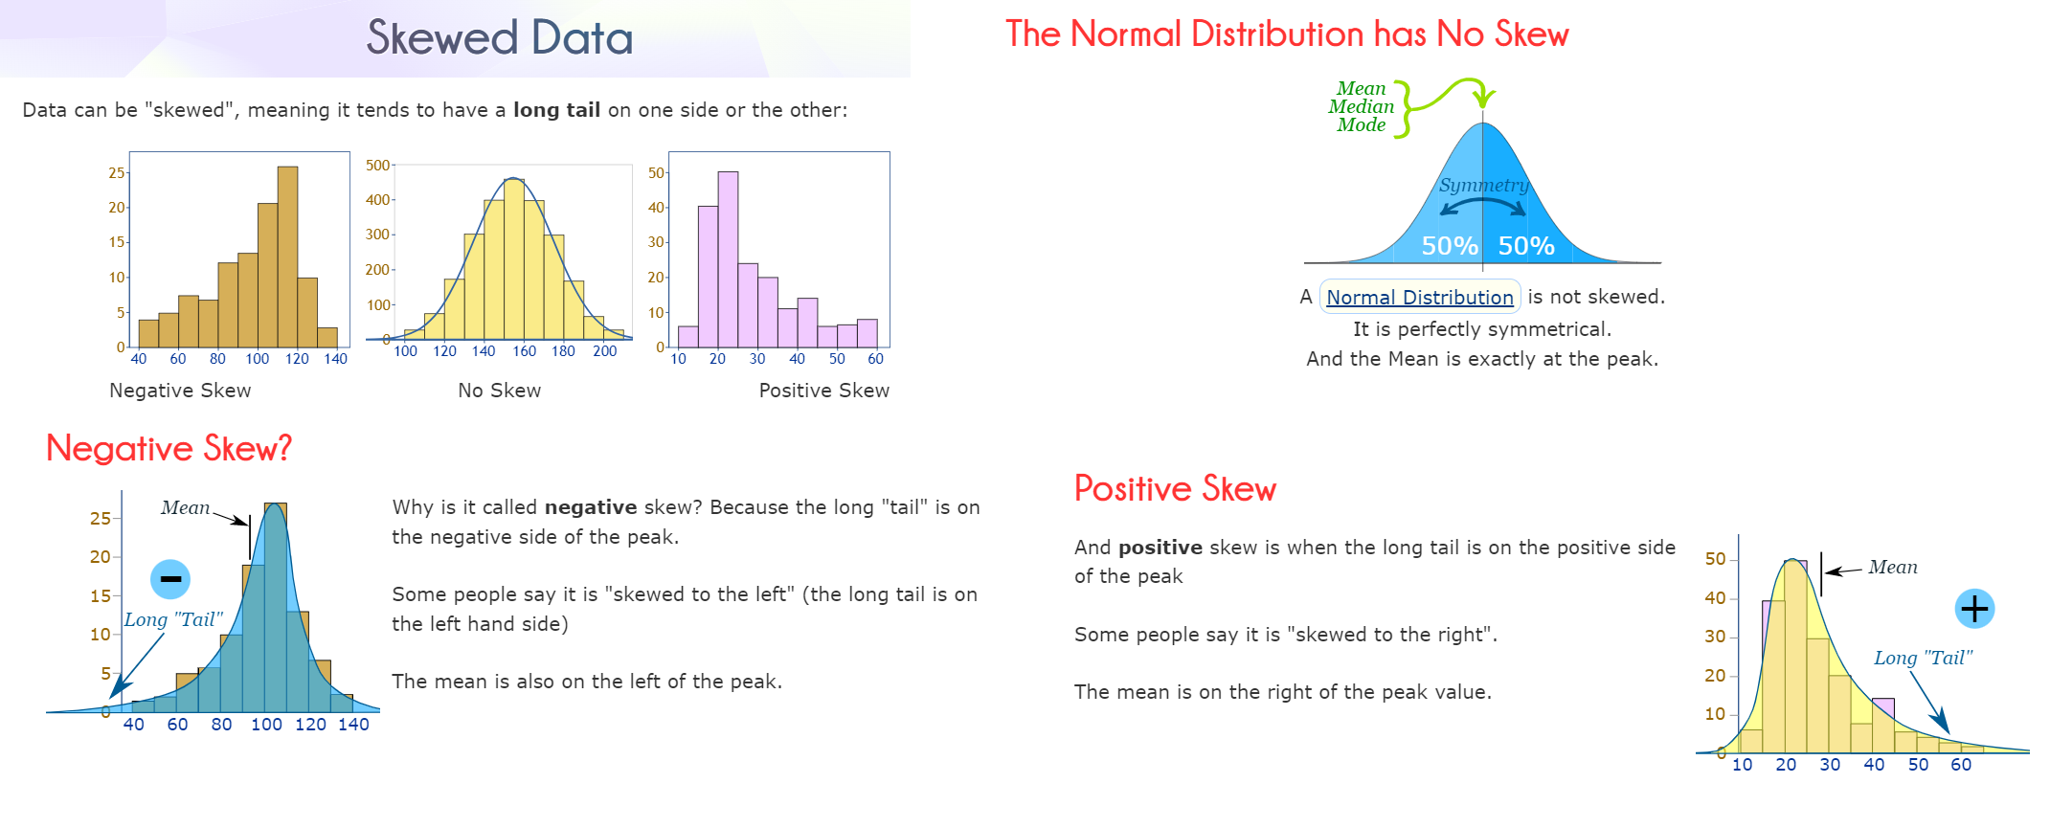

Slide 77
In probability and statistics, the median generally applies to numeric data; however, we may extend the concept to ordinal data
Example: Suppose that a given data set of N values for an attribute X is sorted in increasing order.
If N is odd, then the median is the middle value of the ordered set.
If N is even, then the median is not unique. it is the two middlemost values and any value in between. If X is a numeric attribute in this case, by convention, the median is taken as the average of the two middlemost values

Slide 78
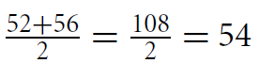
Suppose we have the following values for salary (in thousands of dollars), shown in increasing order: 30, 36, 47, 50, 52, 52, 56, 60, 63, 70, 70, 110
Let’s find the median of the data. The data are already sorted in increasing order.
There is an even number of observations (i.e., 12); therefore, the
median is not unique.
It can be any value within the two middlemost values of 52 and
56 (that is, within the sixth and seventh values in the list). By convention, we assign the average of the two middlemost values as the median; that is,
Thus, the median is $54,000.

Slide 79
Suppose that we had only the first 11 values in the list.
Given an odd number of values, the median is the middlemost value.
This is the sixth value in this list, which has a value of $52,000.
The median is expensive to compute when we have a large number of observations.
For numeric attributes, however, we can easily approximate the value.
Assume that data are grouped in intervals according to their xi data values and that the frequency (i.e., number of data values) of each interval is known
For example, employees may be grouped according to their annual salary in intervals such as $10–20,000, $20–30,000, and so on
Let the interval that contains the median frequency be the median interval.

Slide 80
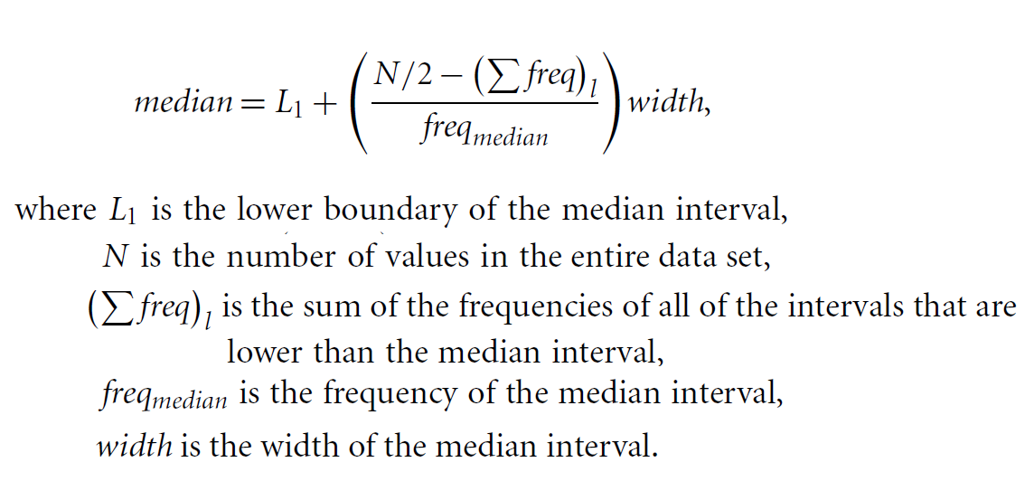
We can approximate the median of the entire data set (e.g., the median salary) by interpolation using the formula

Slide 81
The mode is another measure of central tendency.
The mode for a set of data is the value that occurs most frequently in the set.
Therefore, it can be determined for qualitative and quantitative attributes.
It is possible for the greatest frequency to correspond to several different values, which results in more than one mode.
Data sets with one, two, or three modes are respectively called unimodal, bimodal, and trimodal.
In general, a data set with two or more modes is multimodal.
At the other extreme, if each data value occurs only once, then there is no mode.

Slide 82
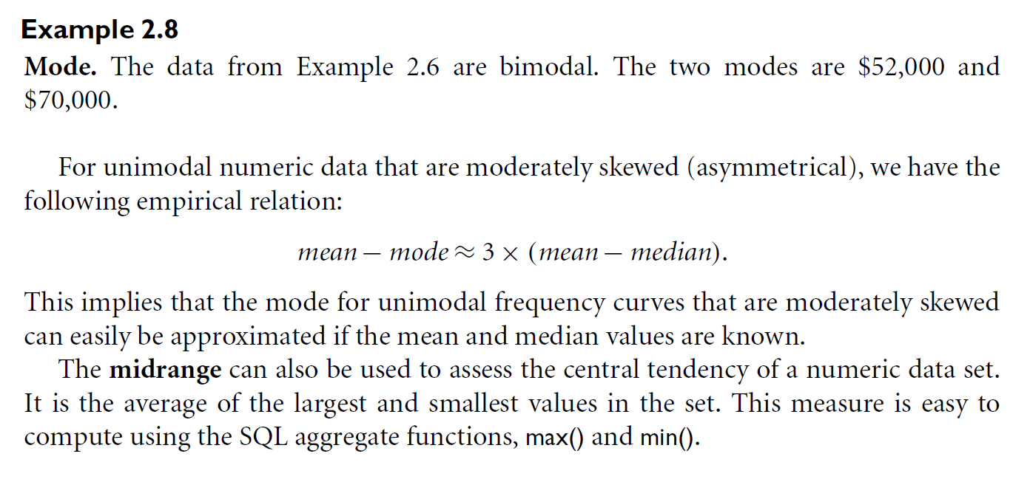
Suppose we have the following values for salary (in thousands of dollars), shown in increasing order: 30, 36, 47, 50, 52, 52, 56, 60, 63, 70, 70, 110

Slide 83
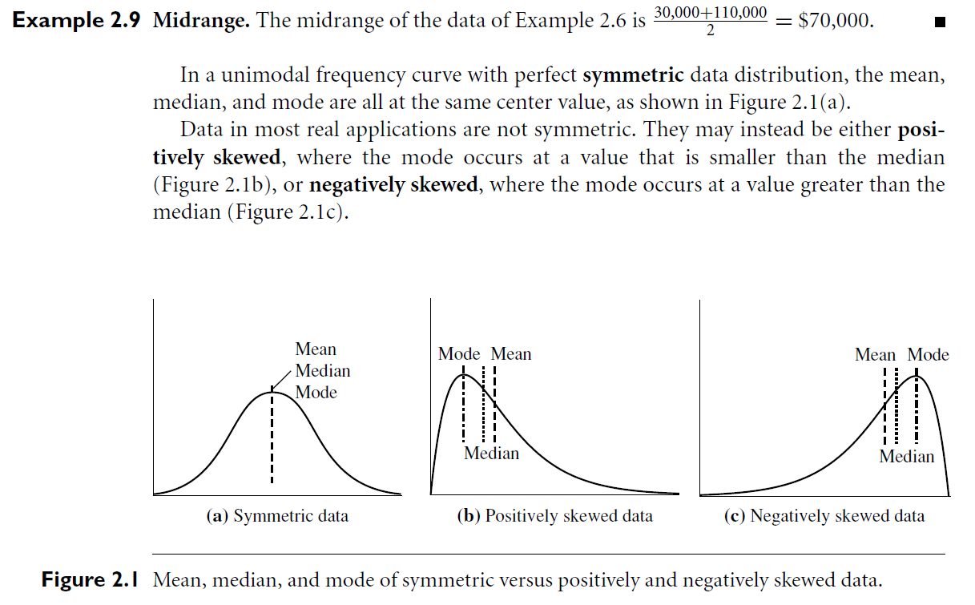

Slide 84
Measuring the Dispersion of Data: Range, Quartiles, Variance,
Standard Deviation, and Interquartile Range
We now look at measures to assess the dispersion or spread of numeric data.
The measures include range, quantiles, quartiles, percentiles, and the interquartile range.
The five-number summary, which can be displayed as a boxplot, is useful in identifying outliers.
Variance and standard deviation also indicate the spread of a data distribution

Slide 85
Range, Quartiles, and Interquartile Range
Let x1,x2, . . . ,xN be a set of observations for some numeric attribute, X. The range of the set is the difference between the largest (max()) and smallest (min()) values.
Range = (Max. Value – Min. Value)
Suppose that the data for attribute X are sorted in increasing numeric order.
Imagine that we can pick certain data points so as to split the data distribution into equal-size consecutive sets. These data points are called quantiles.
Quantiles are points taken at regular intervals of a data distribution, dividing it into essentially equal size consecutive sets.
The 2-quantile is the data point dividing the lower and upper halves of the data distribution. It corresponds to the median.
The 4-quantiles are the three data points that split the data distribution into four equal parts; each part represents one-fourth of the data distribution

Slide 86
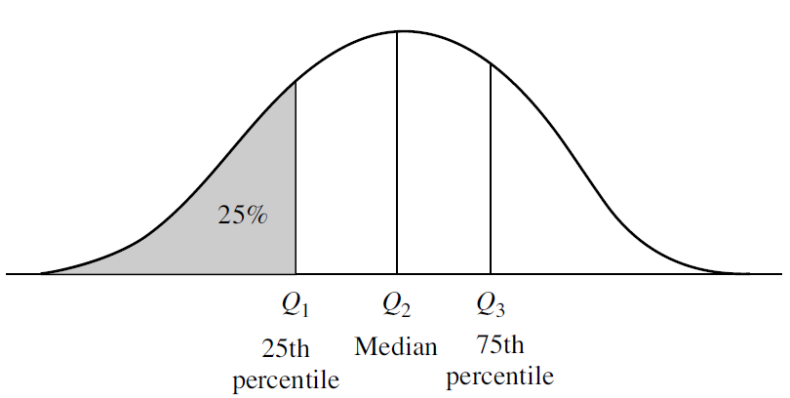
Figure 2.2 A plot of the data distribution for some attribute X. The quantiles plotted are quartiles. The three quartiles divide the distribution into four equal-size consecutive subsets. The second quartile corresponds to the median.

Slide 87
They are more commonly referred to as quartiles.
The 100-quantiles are more commonly referred to as percentiles; they divide the data distribution into 100 equal-sized consecutive sets.
The median, quartiles, and percentiles are the most widely used forms of quantiles.
The quartiles give an indication of a distribution’s center, spread, and shape.
The first quartile, denoted by Q1 is the 25th percentile. It cuts off the lowest 25% of the data.
The third quartile, denoted by Q3, is the 75th percentile—it cuts off the lowest 75% (or highest 25%) of the data.
The second quartile is the 50th percentile. As the median, it gives the center of the data distribution.

Slide 88
The distance between the first and third quartiles is a simple measure of spread that gives the range covered by the middle half of the data. This distance is called the interquartile range (IQR) and is defined as
IQR = Q3 −Q1

Slide 89
Suppose we have the following values for salary (in thousands of dollars), shown in increasing order: 30, 36, 47, 50, 52, 52, 56, 60, 63, 70, 70, 110
Thus, the interquartile range is
.IQR = 63−47 = $16,000. (Note that the sixth value is a median, $52,000, although this data set has two medians since the number of data values is even

Slide 90
Five-Number Summary, Boxplots, and Outliers
Therefore, it is more informative to also provide the two quartiles Q1 and Q3, along with the median.
A common rule of thumb for identifying suspected outliers is to single out values falling at least 1.5×IQR above the third quartile or below the first quartile.
Because Q1, the median, and Q3 together contain no information about the endpoints (e.g., tails) of the data, a fuller summary of the shape of a distribution can be obtained by providing the lowest and highest data values as well. This is known as the five-number summary.

Slide 91
The five-number summary of a distribution consists of the median (Q2), the quartiles Q1 and Q3, and the smallest and largest individual observations, written in the order of Minimum, Q1, Median, Q3, Maximum.
Boxplots are a popular way of visualizing a distribution.
A boxplot incorporates the five-number summary as follows:
Typically, the ends of the box are at the quartiles so that the box length is the interquartile range.
The median is marked by a line within the box.
Two lines (called whiskers) outside the box extend to the smallest (Minimum) and largest (Maximum) observations.

Slide 92
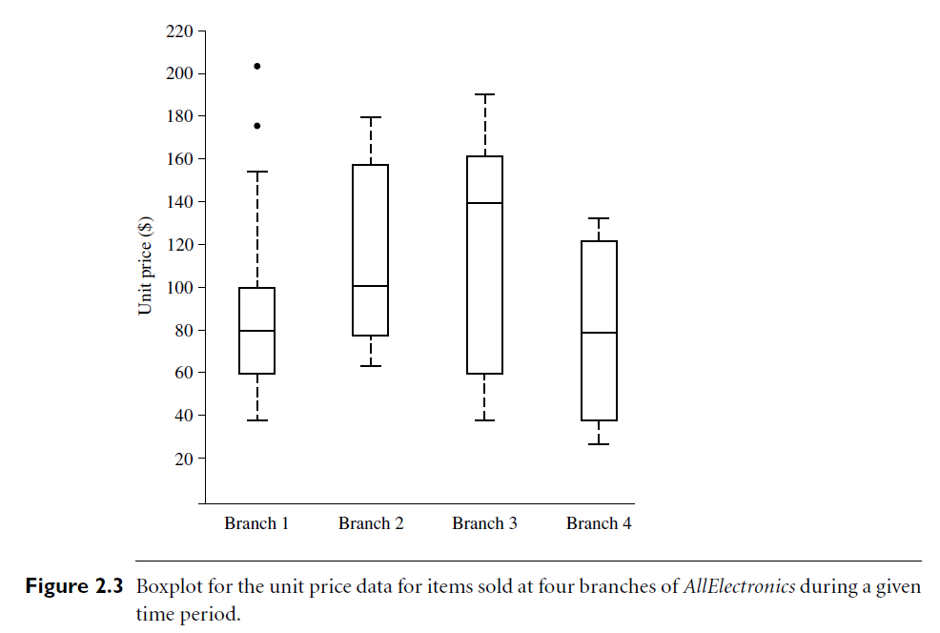

Slide 93
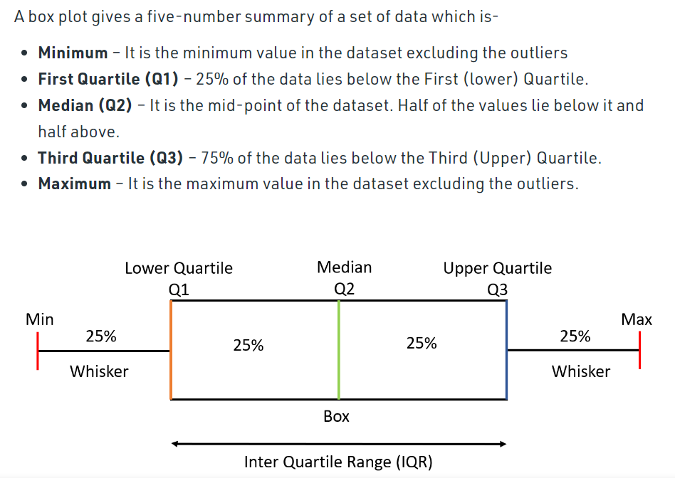

Slide 94
When dealing with a moderate number of observations, it is worthwhile to plot potential outliers individually.
To do this in a boxplot, the whiskers are extended to the extreme low and high observations only if these values are less than 1.5×IQR beyond the quartiles.
Otherwise, the whiskers terminate at the most extreme observations occurring within 1.5×IQR of the quartiles.
Boxplots can be computed in O(nlogn) time

Slide 95
Example:
Let us take a sample data to understand how to create a box plot.
Here are the runs scored by a cricket team in a league of 12 matches – 100,120,110,150,110,140,130,170,120,220,140,110.
To draw a box plot for the given data
First we need to arrange the data in ascending order
Find the minimum, first quartile, median, third quartile and the maximum.
Ascending Order - 100,110,110,110,120,120,130,140,140,150,170,220 Median (Q2) = (120+130)/2 = 125 ; Since there were even values.
To find the First Quartile we take the first six values and find their median
100,110,110,110,120,120
Q1 = (110+110)/2 = 110
For the Third Quartile, we take the next six and find their median
130,140,140,150,170,220
Q3 = (140+150)/2 = 145

Slide 96
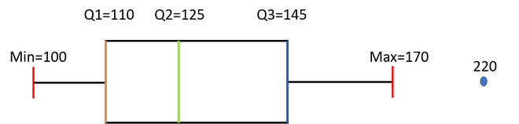
Now, we need to calculate the Inter Quartile Range
IQR = Q3-Q1 = 145-110 = 35
We can now calculate the Upper and Lower Limits to find the minimum and maximum values and also the outliers if any.
Lower Limit = Q1-1.5*IQR = 110-1.5*35 = 57.5
Upper Limit = Q3+1.5*IQR = 145+1.5*35 = 197.5
So the minimum and maximum between the range [57.5,197.5] for our given data are
Minimum = 100 Maximum = 170
The outliers which are outside this range are 220
Outliers = 220

Slide 97
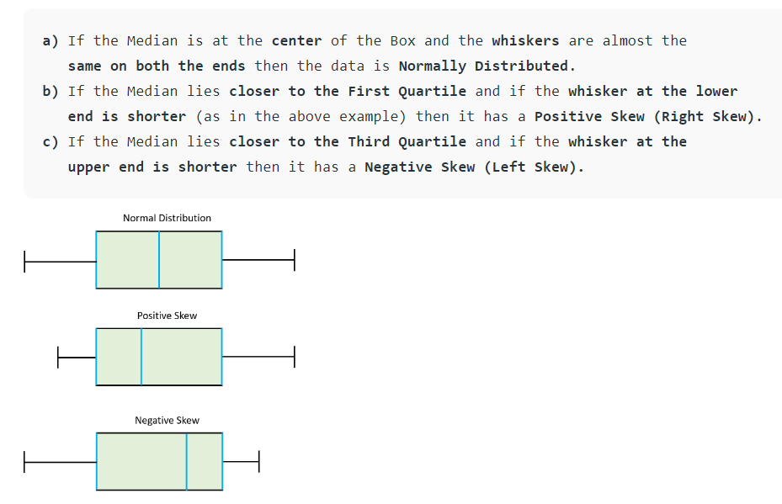

Slide 98
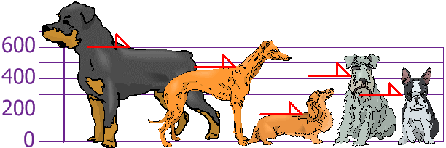
Variance and Standard Deviation
Variance and standard deviation are measures of data dispersion
The Variance is defined as the average of the squared differences
from the Mean
Find out the Mean, the Variance, and the Standard Deviation.
The heights (at the shoulders) are: 600mm, 470mm, 170mm, 430mm and 300mm.

Slide 99
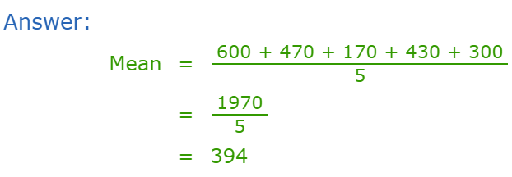
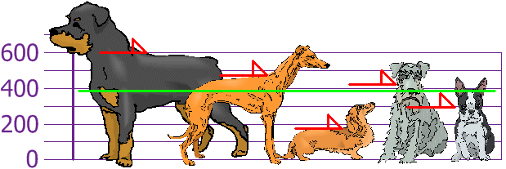
so the mean (average) height is 394 mm. Let's plot this on the chart:

Slide 100
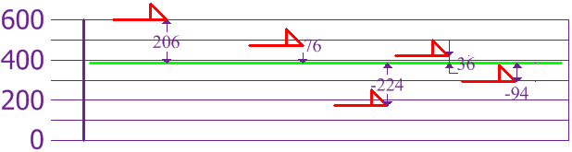
Now we calculate each dog's difference from the Mean:
To calculate the Variance, take each difference, square it, and then average the result:

Slide 101
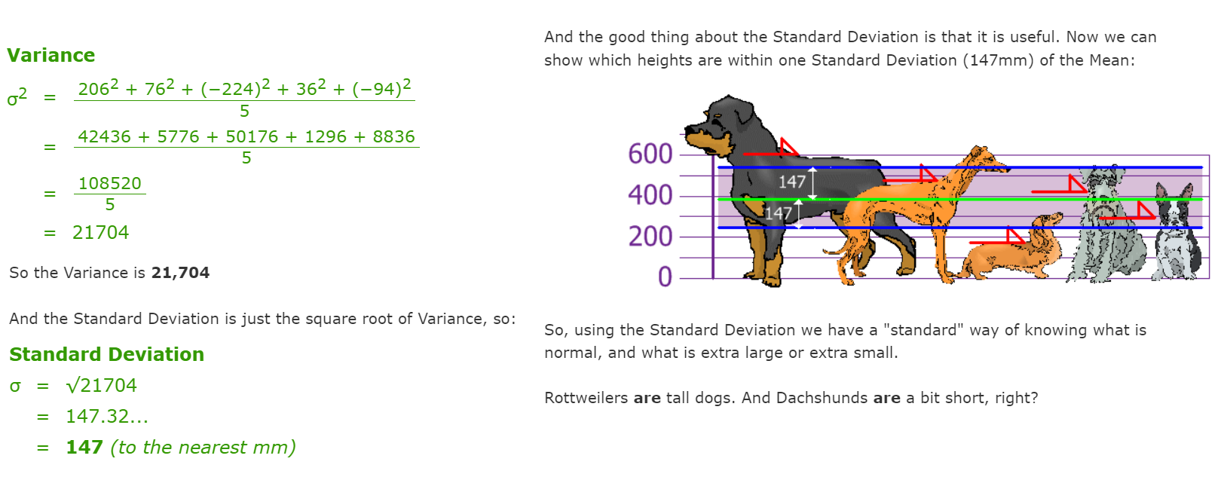

Slide 102
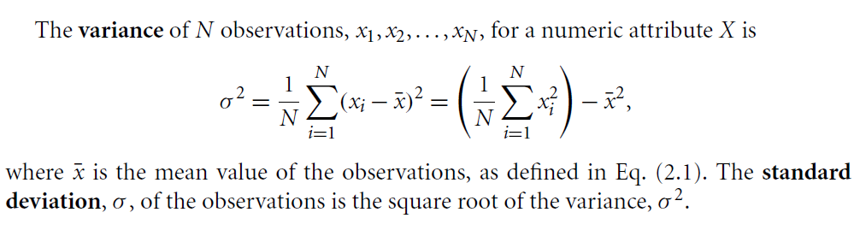

Slide 103
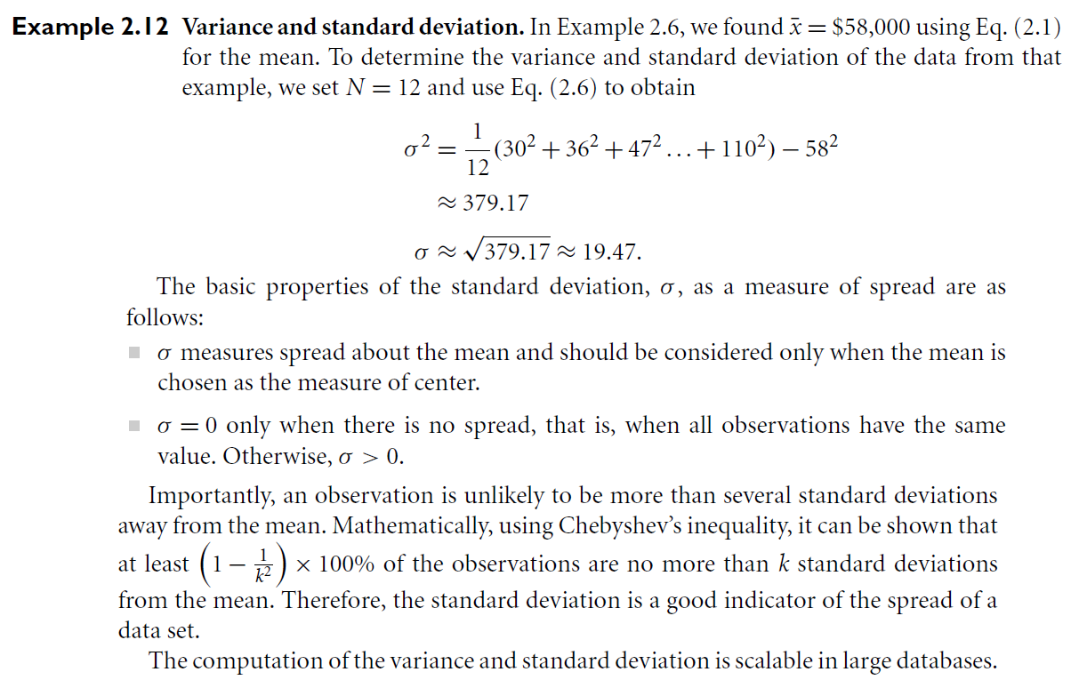

Slide 104
Graphic Displays of Basic Statistical Descriptions of Data
The following are helpful for visual inspection of data which is useful for data preprocessing. These include(quantile plots, quantile–quantile plots, histograms, and scatter plots)
The first three of these show univariate distributions (i.e., data for one attribute)
while scatter plots show bivariate distributions (i.e., involving two attributes).

Slide 105
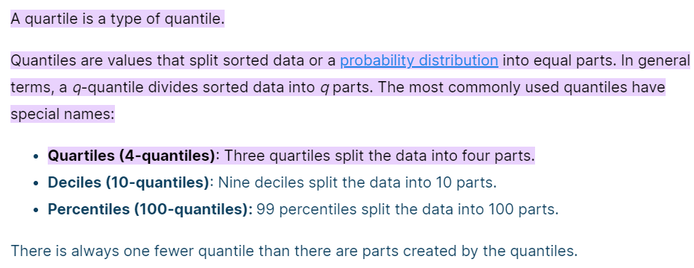
Quantile Plot
A quantile plot is a simple and effective way to have a first look at a univariate data distribution.
Let xi , for i = 1 to N, be the data sorted in increasing order so that x1 is the smallest observation and xN is the largest for some ordinal or numeric attribute X.
Each observation, xi , is paired with a percentage, fi , which indicates
that approximately fi ×100% of the data are below the value, xi .
We say “approximately” because there may not be a value with exactly a fraction, fi , of the data below xi

Slide 106
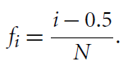
Note
that the 0.25 percentile corresponds to quartile Q1, the 0.50 percentile is the median, and the 0.75 percentile is Q3.
On a quantile plot, xi is graphed against fi .
This allows us to compare different distributions based on their quantiles

Slide 107
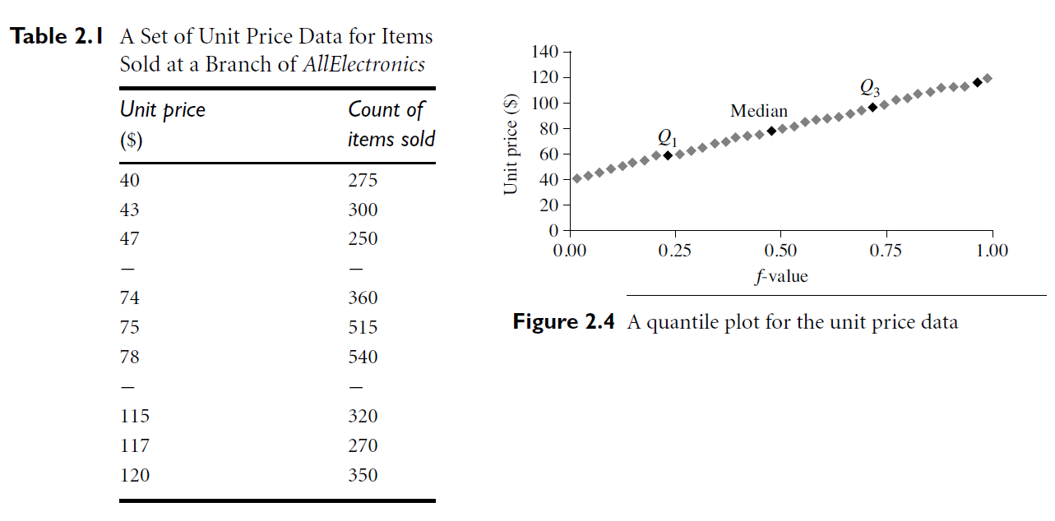
Quantile plot. Figure 2.4 shows a quantile plot for the unit price data of Table 2.1

Slide 108
Quantile–Quantile Plot
A quantile–quantile plot, or q-q plot, graphs the quantiles of one univariate distribution against the corresponding quantiles of another.
It is a powerful visualization tool in that it allows the user to view whether there is a shift in going from one distribution to another.
Suppose that we have two sets of observations for the attribute or variable unit price taken from two different branch locations.
Let x1, . . . ,xN be the data from the first branch, and y1, . . . , yM be the data from the second, where each data set is sorted in increasing order

Slide 109
If M = N (i.e., the number of points in each set is the same), then we
simply plot yi against xi, where yi and xi are both (i −0.5)/N quantiles of their respective data sets.
If M < N (i.e., the second branch has fewer observations than the first),
there can be only M points on the q-q plot. Here, yi is the (i −0.5)/M quantile of the y data, which is plotted against the (i −0.5)/M quantile of the x data. This computation typically involves interpolation

Slide 110
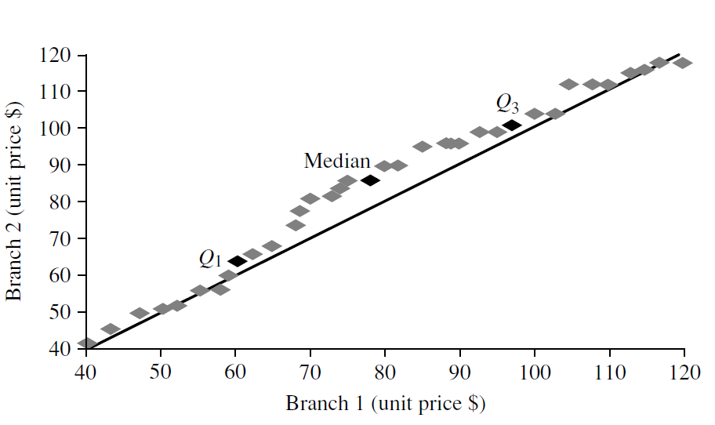
A q-q plot for unit price data from two AllElectronics branches

Slide 111
The above figure shows a quantile–quantile plot for unit price data of items sold at two branches of AllElectronics during a given time period.
Each point corresponds to the same quantile for each data set and shows the unit price of items sold at branch 1 versus branch 2 for that quantile.
To aid in comparison, the straight line represents the case where, for each given quantile, the unit price at each branch is the same.
The darker points correspond to the data for Q1, the median, and Q3, respectively.

Slide 112
We see, for example, that at Q1, the unit price of items sold at branch 1 was slightly less than that at branch 2. In other words, 25% of items sold at branch 1 were less than or equal to $60, while 25% of items sold at branch 2 were less than or equal to $64.
At the 50th percentile (marked by the median, which is also Q2), we see that 50% of items sold at branch 1 were less than $78, while 50% of items at branch 2 were less than $85.
In general, we note that there is a shift in the distribution of branch 1 with respect to branch 2 in that the unit prices of items sold at branch 1 tend to be lower than those at branch 2.

Slide 113
Histograms
Histograms (or frequency histograms) are at least a century old and are widely used.
“Histos” means pole or mast, and “gram” means chart, so a histogram is a chart of poles.
Plotting histograms is a graphical method for summarizing the distribution of a given attribute, X.
If X is nominal, such as automobile model or item type, then a pole
or vertical bar is drawn for each known value of X.
The height of the bar indicates the frequency (i.e., count) of that X value.
The resulting graph is more commonly known as a bar chart.
If X is numeric, the term histogram is preferred.
The range of values for X is partitioned into disjoint consecutive subranges.
The subranges, referred to as buckets or bins, are disjoint subsets of the data distribution for X.
The range of a bucket is known as the width.

Slide 114
Typically, the buckets are of equal width
For example, a price attribute with a value range of $1 to $200 (rounded up to the nearest dollar) can be partitioned into subranges 1 to 20, 21 to 40, 41 to 60, and so on.
For each subrange, a bar is drawn with a height that represents the total count of items observed within the subrange

Slide 115
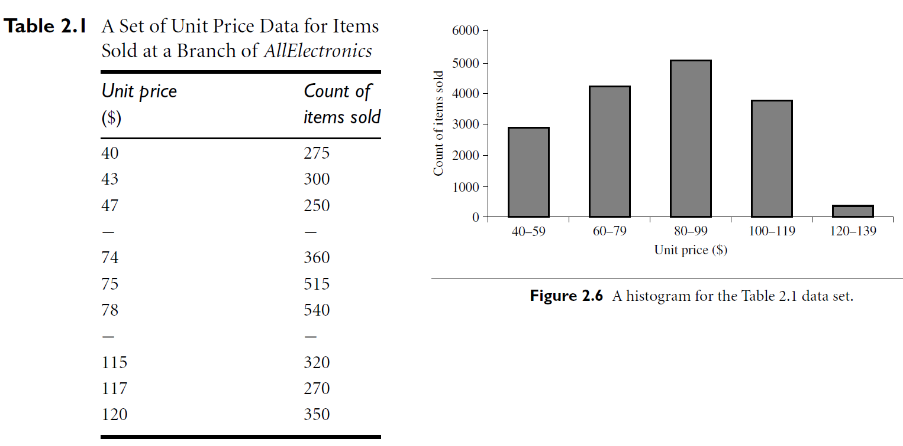

Slide 116
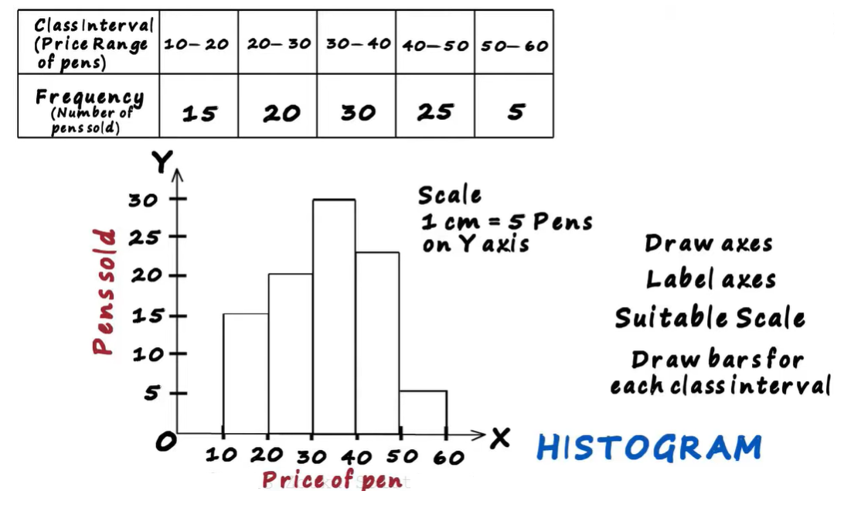
Although histograms are widely used, they may not be as effective as the quantile plot, q-q plot, and boxplot methods in comparing groups of univariate observations.

Slide 117
Scatter Plots and Data Correlation
A scatter plot is one of the most effective graphical methods for determining if there appears to be a relationship, pattern, or trend between two numeric attributes.
To construct a scatter plot, each pair of values is treated as a pair of coordinates in an algebraic sense and plotted as points in the plane.
The scatter plot is a useful method for providing a first look at bivariate data to see clusters of points and outliers, or to explore the possibility of correlation relationships.
Two attributes, X, and Y, are correlated if one attribute implies the other.
Correlations can be positive, negative, or null (uncorrelated)

Slide 118
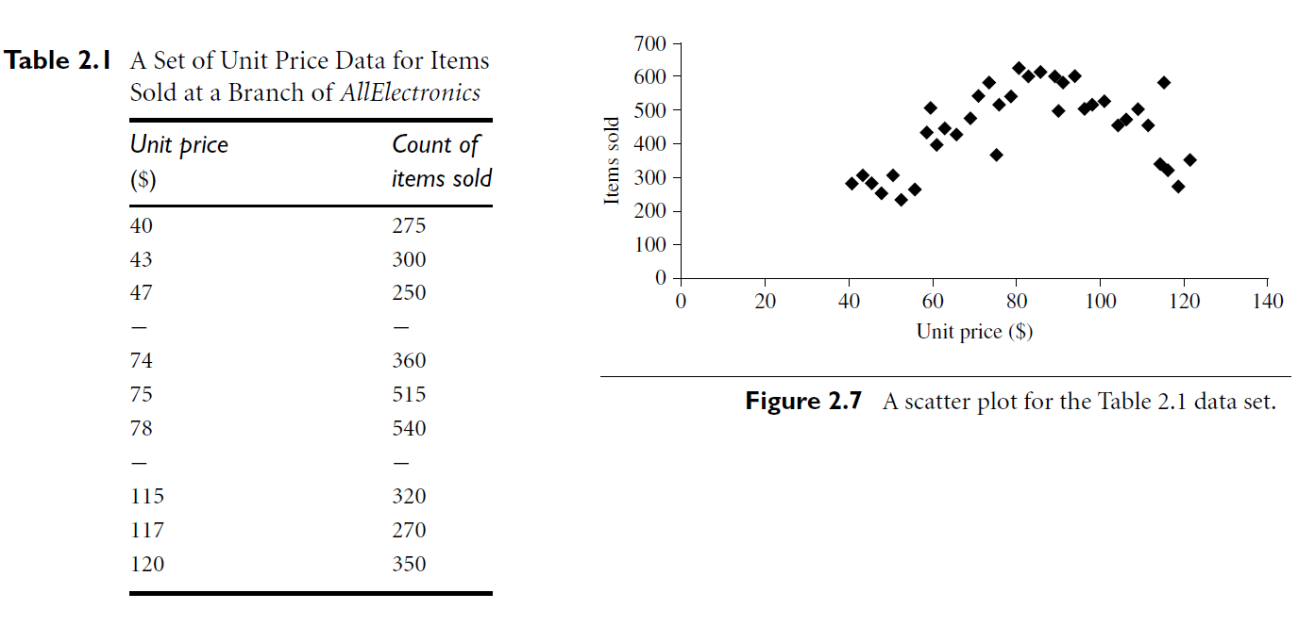

Slide 119
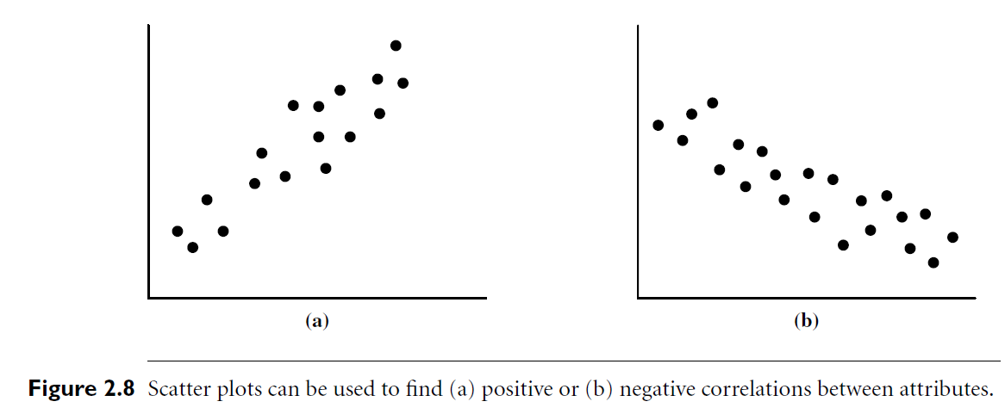
Figure 2.8 shows examples of positive and negative correlations between two attributes

Slide 120
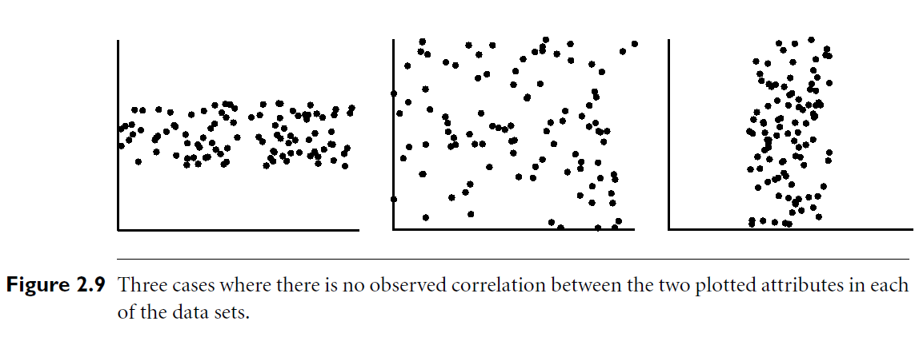

Slide 121
If the plotted points pattern slopes from lower left to upper right, this means that the values of X increase as the values of Y increase, suggesting a positive correlation (Figure 2.8a).
If the pattern of plotted points slopes from upper left to lower right, the values of X increase as the values of Y decrease, suggesting a negative correlation (Figure 2.8b).
A line of best fit can be drawn to study the correlation between the variables

Slide 122
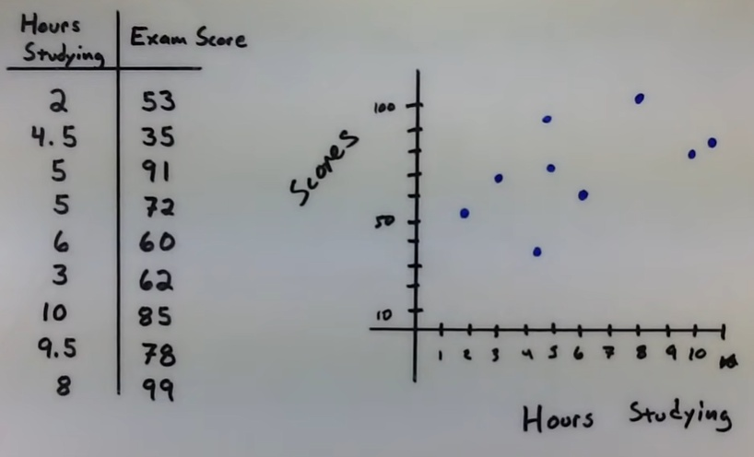

Slide 123
Data Visualization
How can we convey data to users effectively?
Data visualization aims to communicate data clearly and effectively through graphical representation.
Data visualization has been used extensively in many applications.
Example: at work for reporting, managing business operations, and tracking progress of tasks.
More popularly, we can take advantage of visualization techniques to discover data relationships that are otherwise not easily observable by looking at the raw data.

Slide 124
We start with multidimensional data such as those stored in relational databases.
We discuss several representative approaches, including
Pixel-oriented techniques,
Geometric projection techniques,
Icon-based techniques
Hierarchical and graph-based techniques.

Slide 125
Pixel-Oriented Visualization Techniques
A simple way to visualize the value of a dimension is to use a pixel where the color of the pixel reflects the dimension’s value.
For a data set of m dimensions, pixel-oriented techniques create m windows on the screen, one for each dimension.
The m dimension values of a record are mapped to m pixels at the corresponding positions in the windows.
The colors of the pixels reflect the corresponding values.
Inside a window, the data values are arranged in some global order shared by all windows.
The global order may be obtained by sorting all data records in a way that’s meaningful for the task at hand

Slide 126
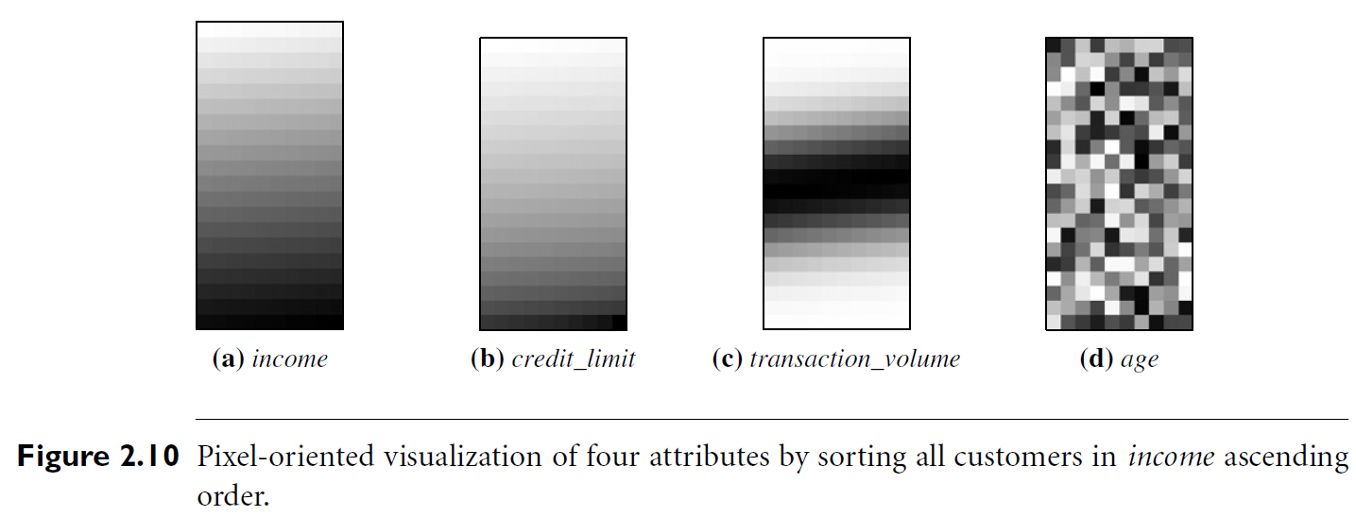
Example: AllElectronics maintains a customer information table, which consists of four dimensions: income, credit limit, transaction volume, and age
Can we analyze the correlation between income and the other attributes by visualization?
We can sort all customers in income-ascending order, and use this order to lay out the customer data in the four visualization windows, as shown in Figure 2.10

Slide 127
The pixel colors are chosen so that the smaller the value, the lighter the shading.
Using pixel based visualization, we can easily observe the following: credit limit increases as income increases;
customers whose income is in the middle range are more likely to purchase more from AllElectronics; there is no clear correlation between income and age.
In pixel-oriented techniques, data records can also be ordered in a query-dependent way.
For example, given a point query, we can sort all records in descending order of similarity to the point query.

Slide 128
Filling a window by laying out the data records in a linear way may not work well for a wide window.
The first pixel in a row is far away from the last pixel in the previous row, though they are next to each other in the global order.
Moreover, a pixel is next to the one above it in the window, even though the two are not next to each other in the global order.
To solve this problem, we can lay out the data records in a space-filling curve to fill the windows.
A space-filling curve is a curve with a range that covers the entire n-dimensional unit hypercube.
Since the visualization windows are 2-D, we can use any 2-D space-filling curve. Figure 2.11 shows some frequently used 2-D space-filling curves

Slide 129
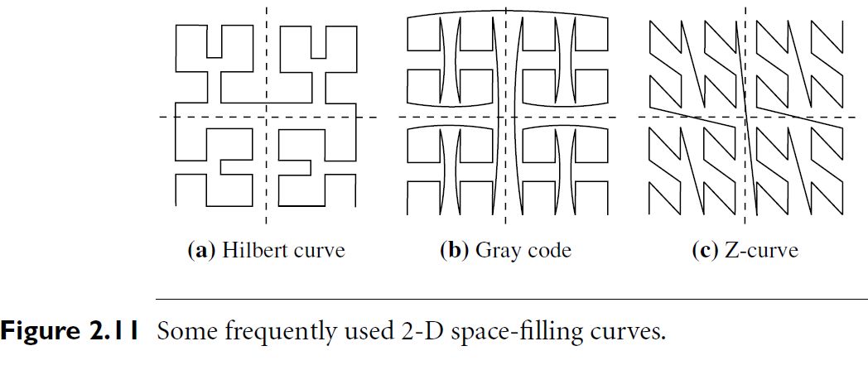

Slide 130
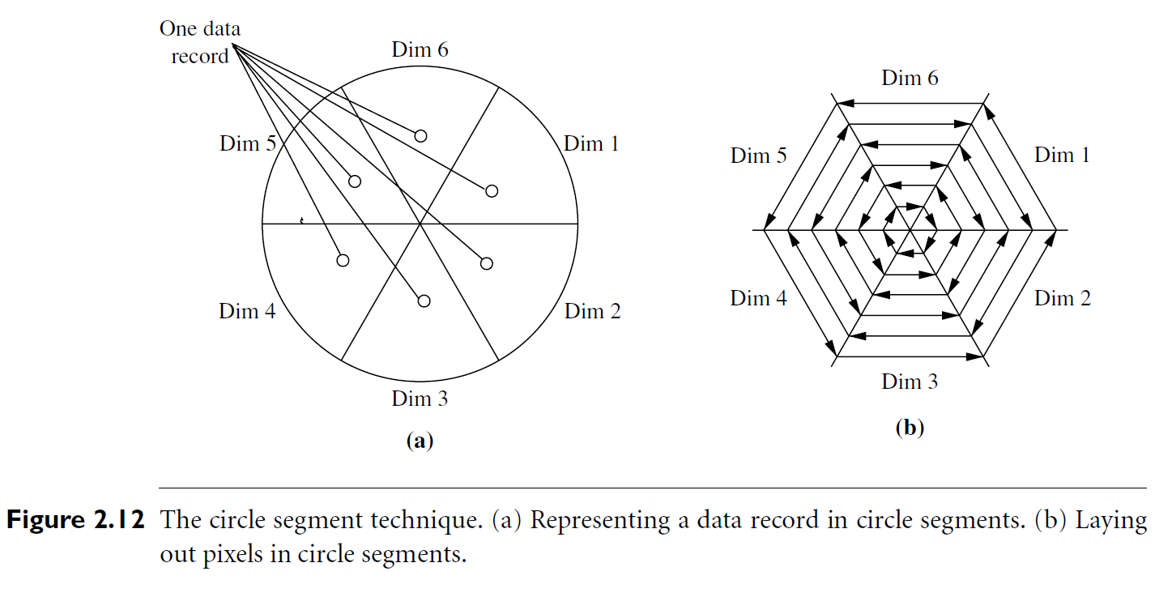
Note that the windows do not have to be rectangular.
For example, the circle segment technique uses windows in the shape of segments of a circle, as illustrated in Figure 2.12

Slide 131
This technique can ease the comparison of dimensions because the dimension windows are located side by side and form a circle

Slide 132
Geometric Projection Visualization Techniques
A drawback of pixel-oriented visualization techniques is that they cannot help us much in understanding the distribution of data in a multidimensional space.
For example, they do not show whether there is a dense area in a multidimensional subspace.
Geometric projection techniques help users find interesting projections of multidimensional data sets.
The central challenge of geometric projection techniques try to address is how to visualize a high-dimensional space on a 2-D display.

Slide 133
A scatter plot displays 2-D data points using Cartesian coordinates.
A third dimension can be added using different colors or shapes to represent different data points.

Slide 134
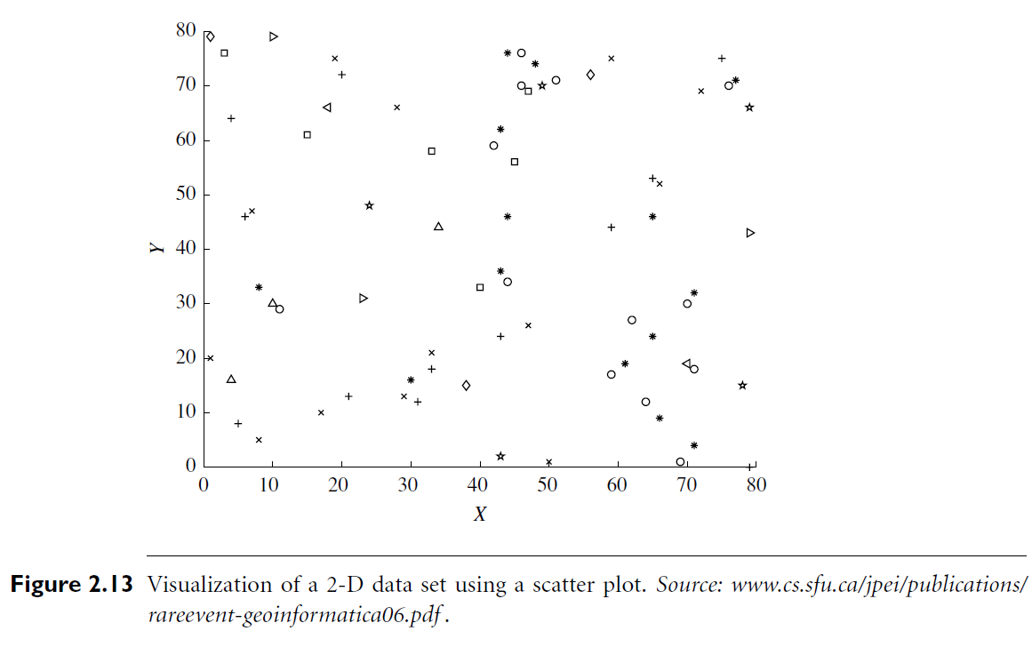
Figure 2.13 shows an example, where X and Y are two spatial attributes and the third dimension is represented by different shapes. Through this visualization, we can see that points of types “+” and “×” tend to be colocated

Slide 135
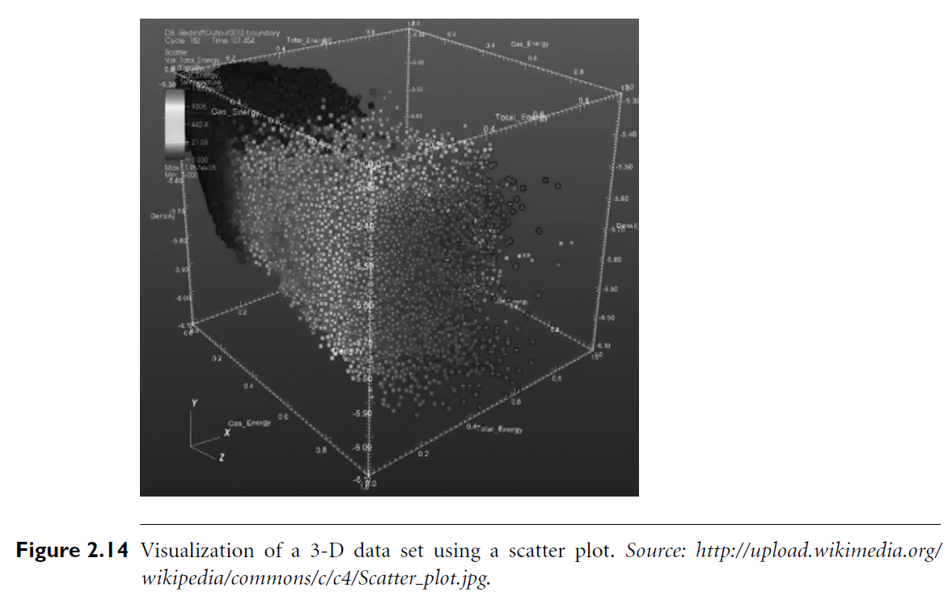
A 3-D scatter plot uses three axes in a Cartesian coordinate system. If it also uses color, it can display up to 4-D data points (Figure 2.14).

Slide 136
For data sets with more than four dimensions, scatter plots are usually ineffective.
The scatter-plot matrix technique is a useful extension to the scatter plot.
For an n dimensional data set, a scatter-plot matrix is an n×n grid of 2-D scatter plots that provides a visualization of each dimension with every other dimension.
Figure 2.15 shows an example, which visualizes the Iris data set
The data set consists of 450 samples from each of three species of Iris flowers.
There are five dimensions in the data set: length and width of sepal and petal, and species.

Slide 137
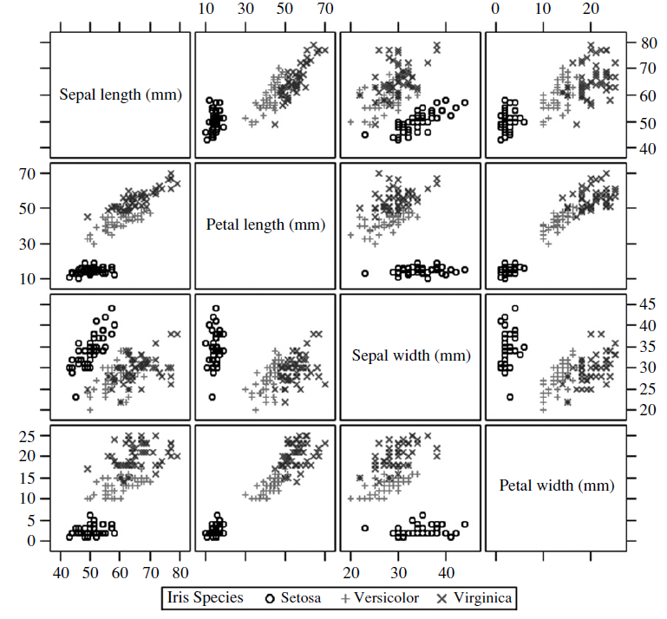
Figure 2.15 Visualization of the Iris data set using a scatter-plot matrix.
Source: http://support.sas.com/ documentation/cdl/en/grstatproc/61948/HTML/default/images/gsgscmat.gif .

Slide 138
Another popular technique, called parallel coordinates, can handle higher dimensionality.
To visualize n-dimensional data points, the parallel coordinates technique drawn equally spaced axes, one for each dimension, parallel to one of the display axes
A data record is represented by a polygonal line that intersects each axis at the point corresponding to the associated dimension value

Slide 139
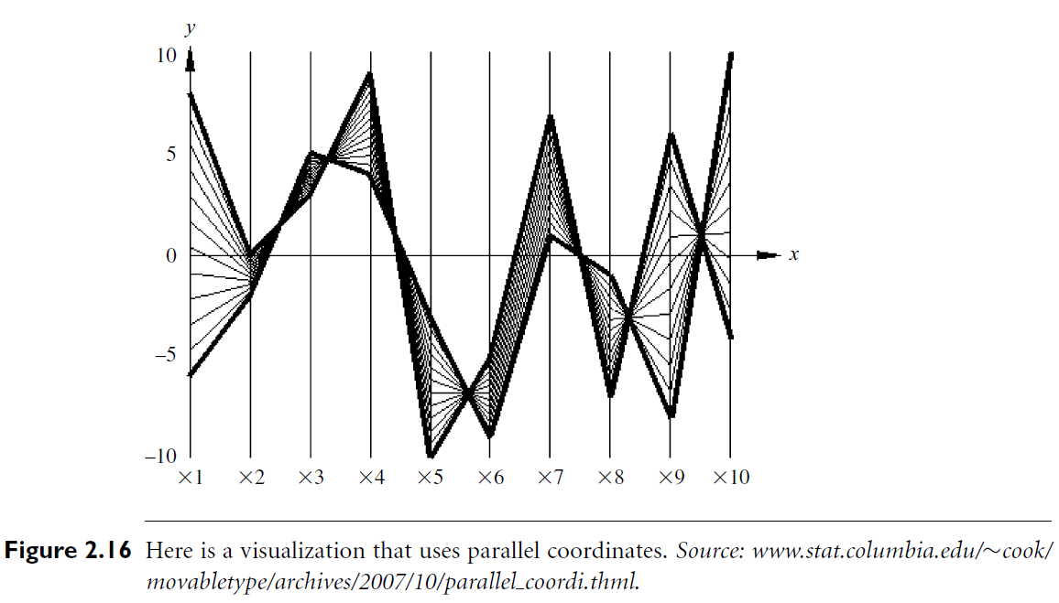

Slide 140
A major limitation of the parallel coordinates technique is that it cannot effectively show a data set of many records.
Even for a data set of several thousand records, visual clutter and overlap often reduce the readability of the visualization and make the patterns hard to find.

Slide 141
Icon-Based Visualization Techniques
Icon-based visualization techniques use small icons to represent multidimensional data values.
we look at two popular icon-based techniques: Chernoff faces and stick figures.
Chernoff faces were introduced in 1973 by statistician Herman Chernoff.
They display multidimensional data of up to 18 variables (or dimensions) as a cartoon human face (Figure 2.17).

Slide 142
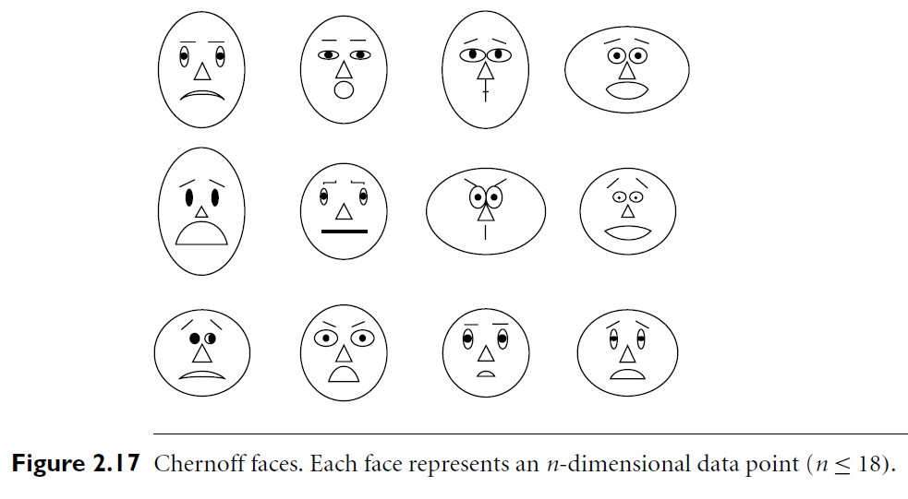
Chernoff faces help reveal trends in the data.
Components of the face, such as the eyes, ears, mouth, and nose, represent values of the dimensions by their shape, size, placement, and orientation

Slide 143
For example,
dimensions can be mapped to the following facial characteristics: eye size, eye spacing, nose length, nose width, mouth curvature, mouth width, mouth openness, pupil size, eyebrow slant, eye eccentricity, and head eccentricity.
Chernoff faces make use of the ability of the human mind to recognize small differences in facial characteristics and to assimilate many facial characteristics at once.
Viewing large tables of data can be tedious.
Chernoff faces make the data easier for users to digest

Slide 144
In this way, they facilitate visualization of regularities and irregularities present in the data, although their power in relating multiple relationships is limited.
This means that the similarity of two faces (representing two multidimensional data points) can vary depending on the order in which dimensions are assigned to facial characteristics.
Asymmetrical Chernoff faces were proposed as an extension to the original technique. Since a face has vertical symmetry (along the y-axis), the left and right side of a face are identical, which wastes space.
Asymmetrical Chernoff faces double the number of facial characteristics, thus allowing up to 36 dimensions to be displayed.

Slide 145
The stick figure visualization technique maps multidimensional data to five-piece stick figures, where each figure has four limbs and a body.
Two dimensions are mapped to the display (x and y) axes and the remaining dimensions are mapped to the angle and/or length of the limbs

Slide 146
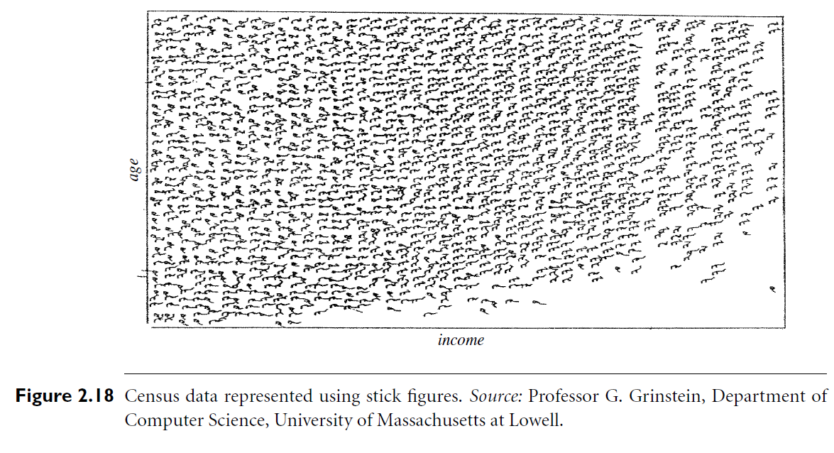
Figure 2.18 shows census data, where age and income are mapped to the display axes, and the remaining dimensions (gender, education, and so on) are mapped to stick figures

Slide 147
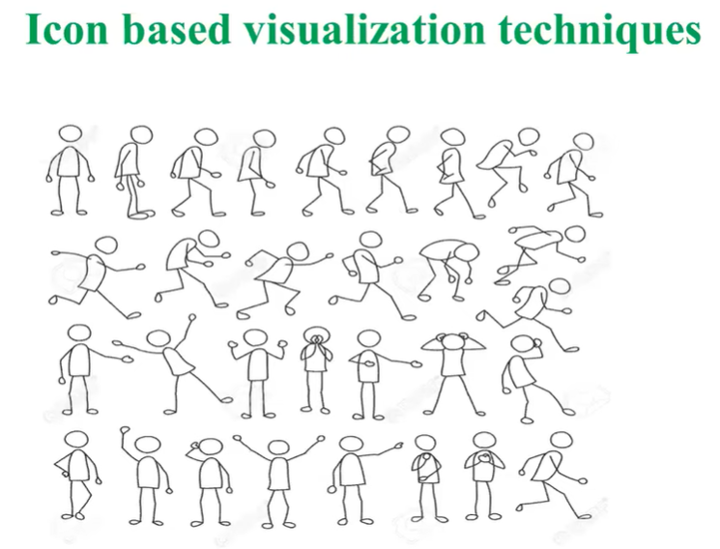

Slide 148
If the data items are relatively dense with respect to the two display dimensions, the resulting visualization shows texture patterns, reflecting
data trends.

Slide 149
Hierarchical Visualization Techniques
The visualization techniques discussed so far focus on visualizing multiple dimensions simultaneously.
However, for a large data set of high dimensionality, it would be difficult to visualize all dimensions at the same time.
Hierarchical visualization techniques partition all dimensions into subsets (i.e., subspaces).
The subspaces are visualized in a hierarchical manner. “Worlds-within-Worlds,” also known as n-Vision, is a representative hierarchical visualization method.

Slide 150
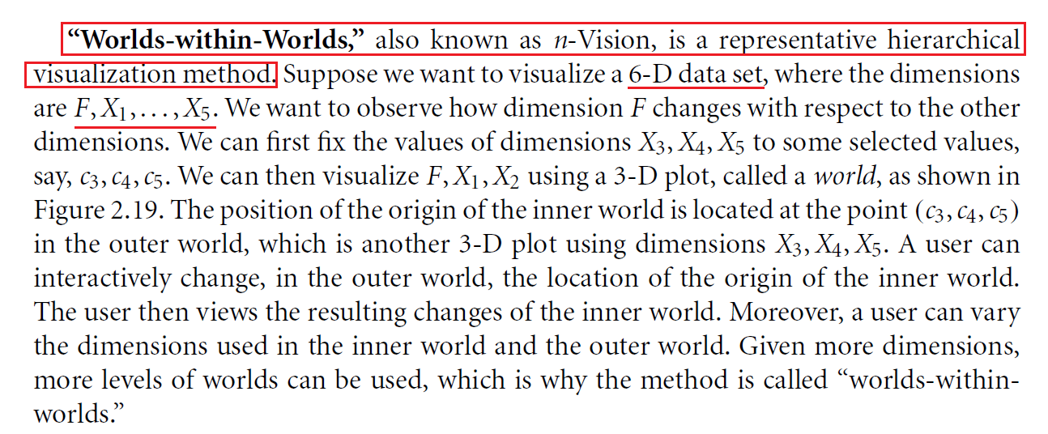

Slide 151


Slide 152


Slide 153
Measuring Data similarity and dissimilarity
In data mining applications, such as clustering, outlier analysis, and nearest-neighbor classification, we need ways to assess how alike or unalike objects are in comparison to one another.
For example, a store may want to search for clusters of customer objects, resulting in groups of customers with similar characteristics (e.g., similar income, area of residence, and age).
Such information can then be used for marketing.
A cluster is a collection of data objects such that the
objects within a cluster are similar to one another and
dissimilar to the objects in other clusters.

Slide 154
Outlier analysis also employs clustering-based techniques to identify potential outliers as objects that are highly dissimilar to others.
Knowledge of object similarities can also be used in nearest-neighbor classification schemes where a given object (e.g., a patient) is assigned a class label (relating to, say, a diagnosis) based on its similarity toward other objects in the model.
This section presents similarity and dissimilarity measures, which are referred to as measures of proximity.
Similarity and dissimilarity are related.
A similarity measure for two objects, i and j, will typically return the value 0 if the objects are unalike.

Slide 155
The higher the similarity value, the greater the similarity between objects. (Typically, a value of 1 indicates complete similarity, that is, the objects are identical.)
A dissimilarity measure works the opposite way
It returns a value of 0 if the objects are the same (and therefore, far from being dissimilar).
The higher the dissimilarity value, the more dissimilar the two objects are.

Slide 156
Data Matrix versus Dissimilarity Matrix
In this section, we talk about objects described by multiple attributes.
Therefore, we need a change in notation. Suppose that we have n objects (e.g., persons, items, or courses) described by p attributes (also called measurements or features, such as age, height, weight, or gender).
The objects are x1 = (x11,x12, . . . ,x1p), x2 = (x21,x22, . . . ,x2p), and so on, where Xij is the value for object xi of the jth attribute.
The objects may be tuples in a relational database, and are also referred to as data samples or feature vectors.

Slide 157

Main memory-based clustering and nearest-neighbor algorithms typically operate on either of the following two data structures:
Each row corresponds to an object. As part of our notation, we may use f to index through the p attributes.

Slide 158


Slide 159


Slide 160
Proximity Measures for Nominal Attributes
A nominal attribute can take on two or more states.
For example, map color is a nominal attribute that may have, say, five states: red, yellow, green, pink, and blue.
Let the number of states of a nominal attribute be M
The states can be denoted by letters, symbols, or a set of integers, such as 1, 2, . . . , M.
Notice that such integers are used just for data handling and do not represent any specific ordering

Slide 161


Slide 162



Slide 163


Slide 164


Slide 165
Proximity Measures for Binary Attributes
Let’s look at dissimilarity and similarity measures for objects described by either symmetric or asymmetric binary attributes.

Slide 166


Slide 167

If objects i and j are described by symmetric binary attributes, then the dissimilarity between i and j is

Slide 168


Slide 169
The coefficient sim(i, j) of Eq. (2.15) is called the Jaccard coefficient and is popularly referenced in the literature.
When both symmetric and asymmetric binary attributes occur in the same data set, the mixed attributes approach described in Section 2.4.6 can be applied.

Slide 170


Slide 171


Slide 172
Dissimilarity of Numeric Data: Minkowski Distance
we describe distance measures that are commonly used for computing
the dissimilarity of objects described by numeric attributes. These measures include the Euclidean, Manhattan, and Minkowski distances.
In some cases, the data are normalized before applying distance calculations
In some cases, the data are normalized before applying distance calculations. This involves transforming the data to fall within a smaller or common range, such as [−1, 1] or [0.0, 1.0]. Consider a height attribute, for example, which could be measured in either meters or inches. In general, expressing an attribute in smaller units will lead to a larger
range for that attribute, and thus tend to give such attributes greater effect or “weight.” Normalizing the data attempts to give all attributes an equal weight. It may or may not be useful in a particular application.

Slide 173


Slide 174


Slide 175


Slide 176


Slide 177


Slide 178
Proximity Measures for Ordinal Attributes
The values of an ordinal attribute have a meaningful order or ranking about them, yet the magnitude between successive values is unknown.
An example includes the sequence small, medium, large for a size attribute.
Ordinal attributes may also be obtained from the discretization of numeric attributes by splitting the value range into a finite number of categories.
These categories are organized into ranks
That is, the range of a numeric attribute can be mapped to an ordinal attribute f having Mf states.
For example, the range of the interval-scaled attribute temperature (in Celsius) can be organized into the following states: −30 to −10, −10 to 10, 10 to 30, representing the categories cold temperature, moderate temperature, and warm temperature, respectively. Let M represent the number of possible states that an ordinal attribute can have. These ordered states define the ranking 1, . . . , Mf

Slide 179


Slide 180


Slide 181

Dissimilarity for Attributes of Mixed Types
However, in many real databases, objects are described by a mixture of attribute types. In general, a database can contain all of these attribute types.

Slide 182


Slide 183


Slide 184


